Slide 1

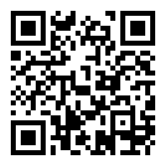
Presentation
Feedback
15 May 2018
https://goo.gl/forms/A3vF9SX01RNiXW1Q2

