Slide 1


Efficiency without compromise for Transport Networks
IRSTE & IRSE Convention, 28th April, New Delhi

Slide 2
Safe Harbor
This presentation contains "forward-looking" statements that involve risks, uncertainties and assumptions. If the risks or uncertainties ever materialize or the assumptions prove incorrect, our results may differ materially from those expressed or implied by such forward-looking statements. All statements other than statements of historical fact could be deemed forward-looking, including, but not limited to, any projections of financial information; any statements about historical results that may suggest trends for our business; any statements of the plans, strategies, and objectives of management for future operations; any statements of expectation or belief regarding future events, potential markets or market size, technology developments, or enforceability of our intellectual property rights; and any statements of assumptions underlying any of the items mentioned.
These statements are based on estimates and information available to us at the time of this presentation and are not guarantees of future performance. Actual results could differ materially from our current expectations as a result of many factors, including but not limited to: aggressive business tactics by our competitors, our dependence on a single product, our reliance on single-source suppliers, our ability to protect our intellectual property, claims by others that we infringe their intellectual property, and our ability to respond to rapid technological changes, and other risks that may impact our business are set forth in our annual reports on Form 10-K filed with the Securities and Exchange Commission, as well as subsequent reports filed with or furnished to the SEC. These reports are available on our website at www.infinera.com and the SEC’s website at www.sec.gov. We assume no obligation to, and do not currently intend to, update any such forward-looking statements.
Notes:
Folks I have to start out with Infinera’s Safe Harbor statement as this presentation does contain forward looking statements.

Slide 3

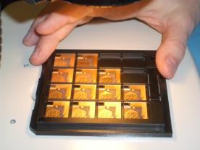
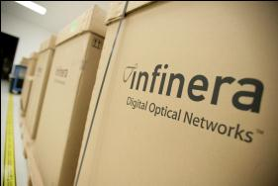
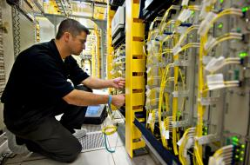
Who is Infinera
Innovator
  Founded 2001 in Silicon Valley, IPO 2007
  Transformed Optical Transport Market
  Pioneered Photonic Integrated Circuits (PICs)
  First to integrate DWDM with OTN switching
  Significant Intellectual Property: 320 Patents Filed/Granted

Slide 4

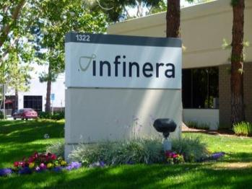
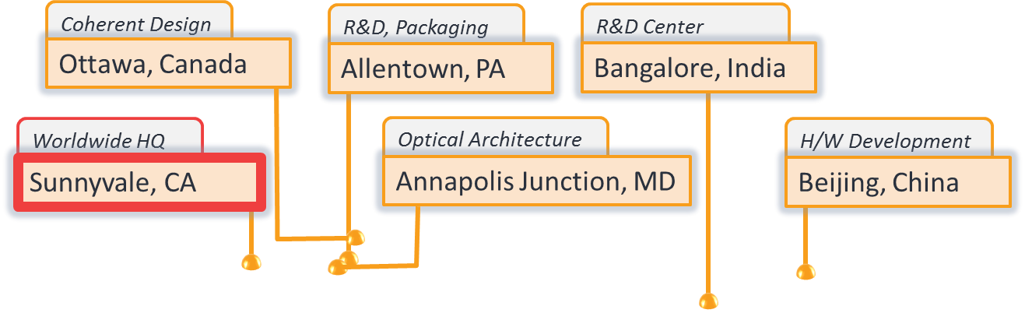

Who is Infinera
Global with Local presence
  ~1,200 employees, HQ: California USA
  Bangalore R&D since 2002 (1 year after founding)
  Presence in 20 countries, Round-the-clock support 143 depots in 25 countries
Infinera Engineering Locations

Slide 5
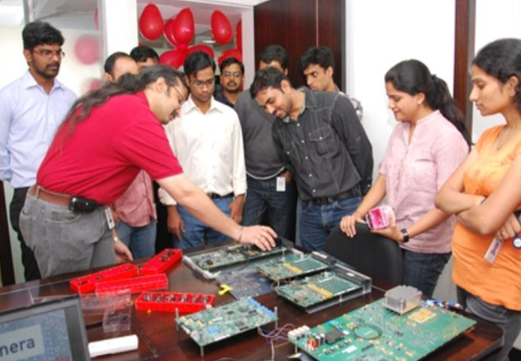
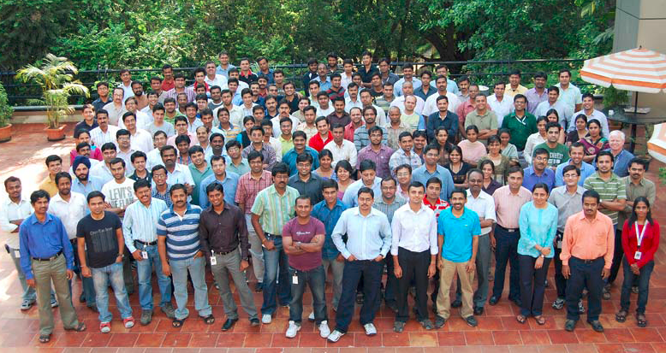
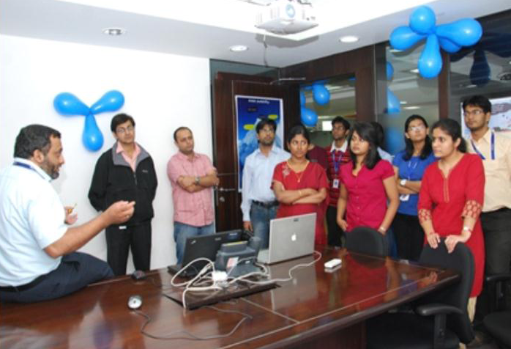
Who is Infinera (in India)
Investing locally
  ~350 employees
  Bangalore R&D since 2002 (1 year after founding)
  Center of engineering excellence
      GMPLS, Network Planning & Management
      ASIC Silicon chips, Hardware Design, Test labs
      Generating patents, developing standards
  Expanding sales & services operations to support innovative customers

Slide 6
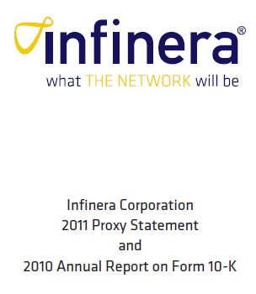











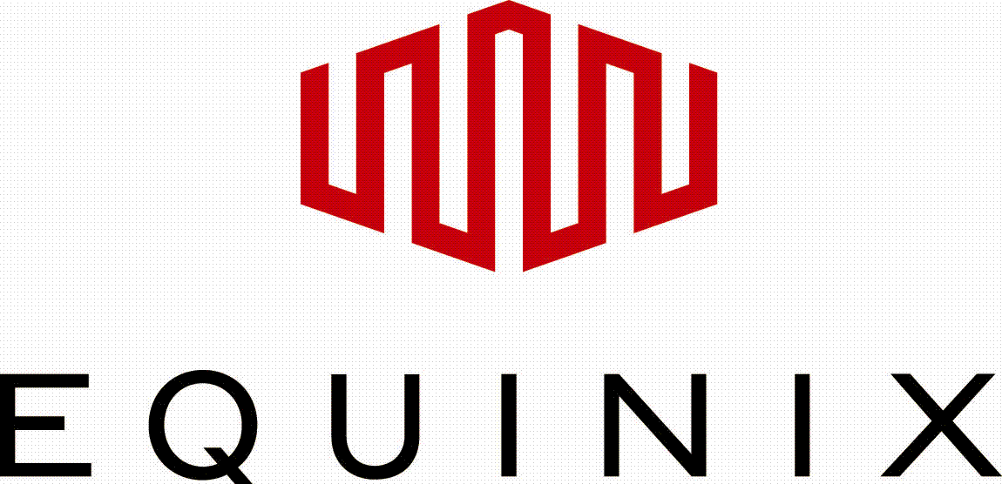



Who is Infinera
Industry Leader
  Zero debt company
  #1 Market Share in NA Long Haul, #4 WW
  100 Customers in 53 Countries
  Over 40% buying multiple product solutions
Source: ACG 4Q11 Optical Network HW

Slide 7

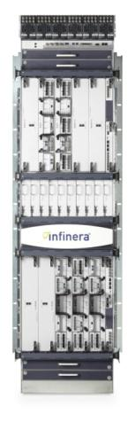
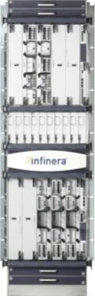
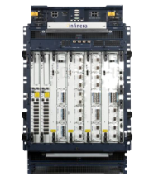
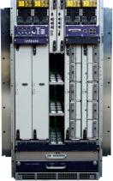

Broad portfolio of transport systems; transforming the optical layer to a Digital Optical Network
DTN-X XTC-10
DTN-X Multi-Bay
ATN
DTN
DTN-X XTC-4
400Gbps / fiber
Metro WDM access integrated w/DTN
1.6 (6.4)Tbps / fiber
400Gbps
Integrated DWDM & OTN switching
8Tbps / fiber
2 - 4 Tb/s
Integrated DWDM/OTN
8Tbps / fiber
5-10 Tb/s
Integrated DWDM/P-OTN
24Tbps / fiber
50-100 Tb/s
Multi-Chassis
DWDM/P-OTN
Common OS, DNA Management & Global Support

Slide 8
Business challenges
Network challenges
Boosting network efficiency
Enabling customer success

Slide 9




Increasing business complexities
Customers
Business, Consumer
Investors
Wall Street, Private
Growing bandwidth
Rapid provisioning
Reliable service
Opex / Revenue
Capex / Revenue
Growth Plans
Service Provider
Intensifying Competition
New Business Models

Slide 10
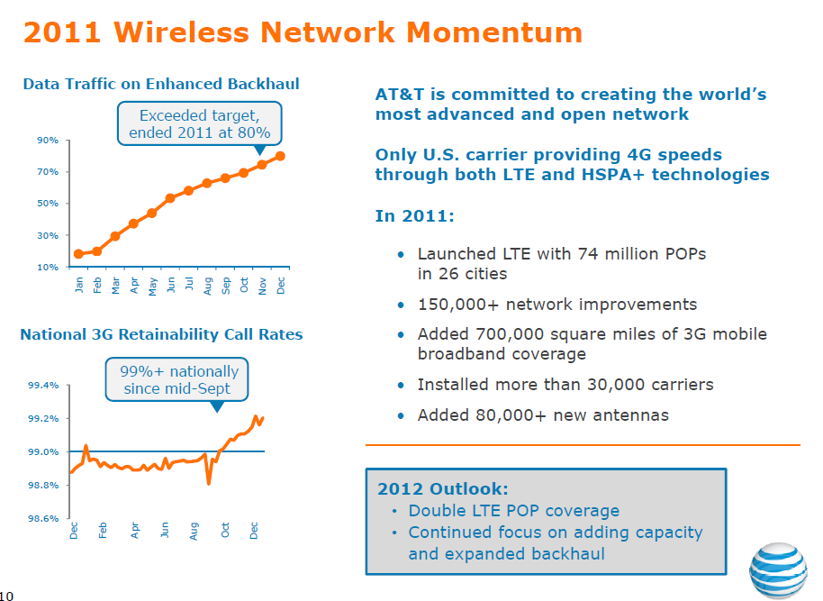
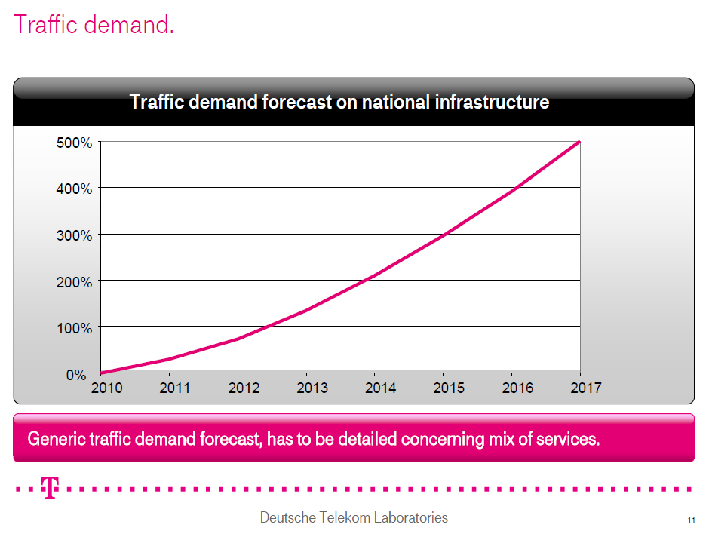
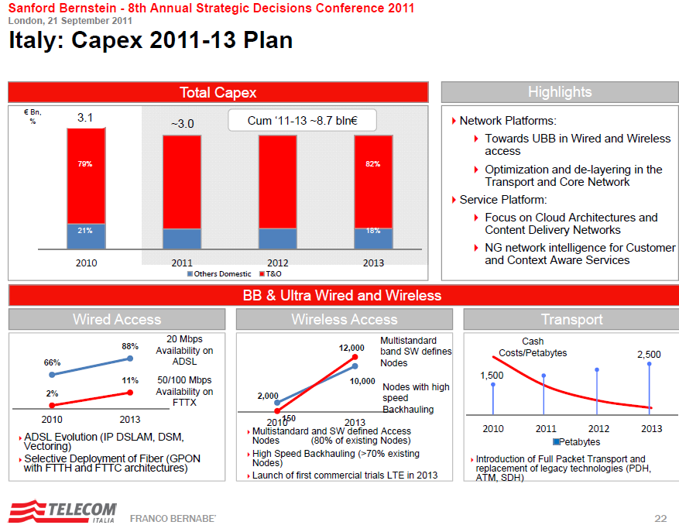
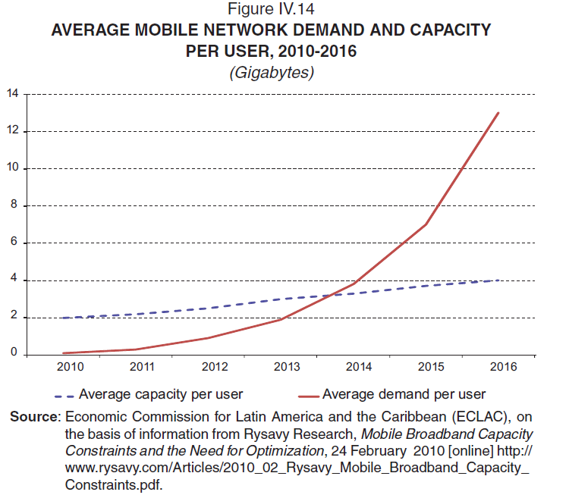
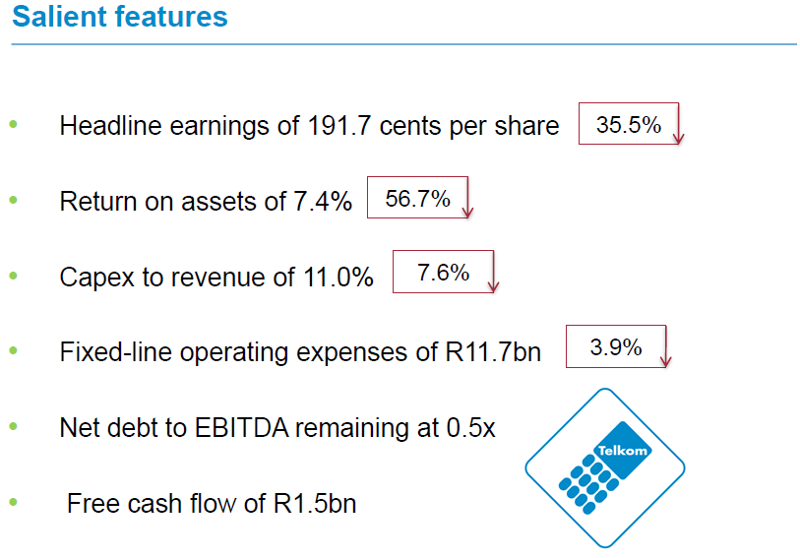
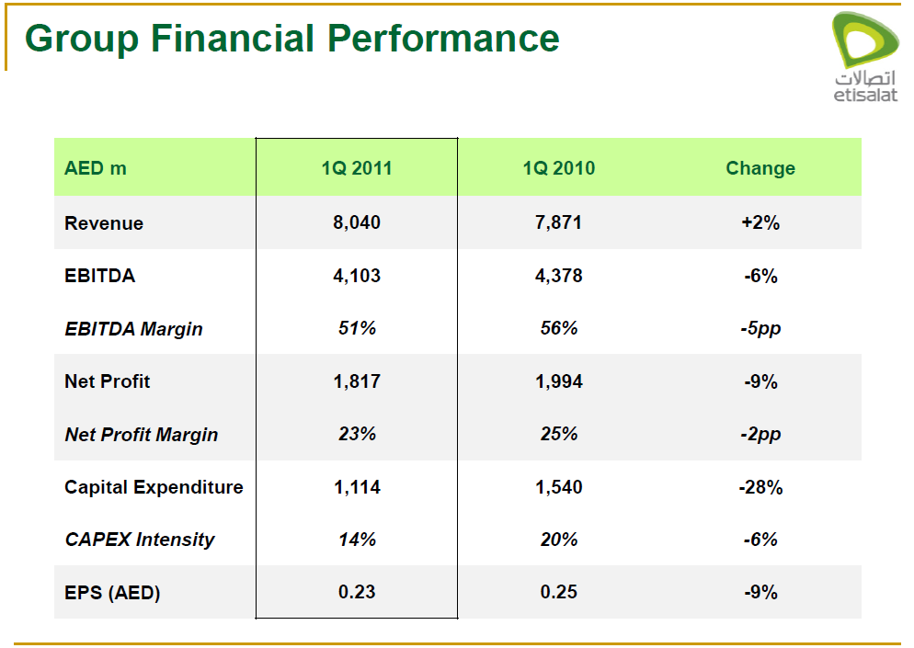
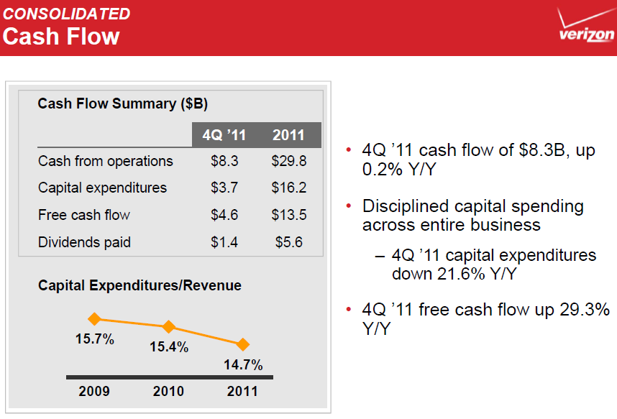






Financial metrics mismatched to bandwidth
Cloud
Video
Mobility
Capex + Opex / Revenue = Flat
Source: Telegeography 2011, Various SP financial statements

Slide 11

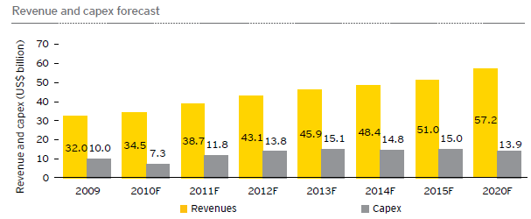
Unique regional characteristics
Unbounded opportunities
Subscriber base and tele-density
Broadband penetration
Mobile services (M2M, m-commerce)
Global market expansion
SP bandwidth usage
How can carriers make 40% EBIDTA margin at 2 cents / min tariff?
Optimal use of scarce resources
Increase network utilization
Innovative business models
Capex + Opex / Revenue = Flat
Source: FICCI, Ernst & Young India Telecom Study 2011

Slide 12
Business challenges
Network challenges
Boosting network efficiency
Enabling customer success
Notes:
Let us now step back to discuss why we are here today- the industry challenges, the need for radical innovation and how Infinera wins.
Click

Slide 13
Driven by network challenges of…..
Bandwidth Scale and Mismatch
Services = Transport
i.e. Client = Line
Line-side DWDM Scaling to Nx100G/Tbps
10G λ
Line
10G λ
Line
100G, 500G λ
Line
1T λ
Line
≤ 2.5G Services
≤ 10G Services
≤ 10G Services
40G λ
Line
≤ 10G Services
≤ 10G Services
Service
Mix
by Bandwidth
Short period
Majority Client Service Demands still ≤ 10G
Source: Ovum 2011

Slide 14





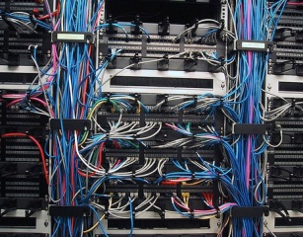

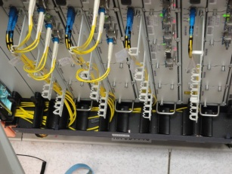


Driven by network challenges of…..
Functional Complexity
Broadband Users
Data Center
Route
Complex multi-layer ops
∑ (devices, connections, resources)
IP/MPLS
Electrons
Moore’s Law applied via IC
Switch
OTN
SDH
SONET
DWDM
Transport
Photons
? Law
Service Provider Network
Notes:
The challenge with having multiple technology layers is the complexity it introduces
As we see here each layer adds new devices, numerous connections between them and of course people resources needed to manage them.
All of this starts blowing up operational expenses and our customers are considerably challenged to keep them in control.
Now it’s also important to examine the market segments for each of these technology layers as tracked in the industry
From it we understand opportunity that Infinera has in addressing customer challenges.
Click

Slide 15
Network challenges collide with growing TCO
Total Cost of Ownership (TCO): Capex is big, Opex is bigger
Power
Space
Cooling
Quality
Planning
Operations
Inventory
Depreciation
Source: Infonetics Research – SP Capex, Opex, ARPU Update for 50+ SPs, December 2011

Slide 16
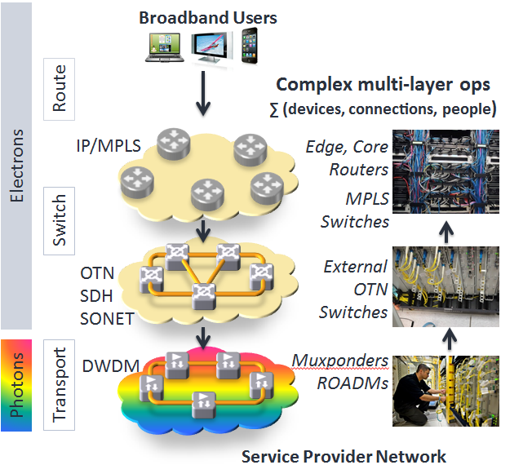
Quantum solutions needed by SPs to make transport networks more efficient
Optimization
Key resource in Transport & Core = Bandwidth, fulfilled by Fibers & Wavelengths
4x10G
Services
100G λ
De-layering
Key issue in Transport & Core = Device Proliferation, leading to Space/Power/Capex inefficiencies
Source: Telecom Italia Investors Conference 2011

Slide 17
Business challenges
Network challenges
Boosting network efficiency
Enabling customer success
Notes:
Let us now step back to discuss why we are here today- the industry challenges, the need for radical innovation and how Infinera wins.
Click

Slide 18

Optimizing bandwidth between client & line
Optimization
Handling Network Bandwidth Mismatch
Client (Service)
Line (Transport)
OTN provides two flexible & independent functions
Multiplexing
Switching
Wavelength, λ
3x10G, 1x1G
Services
Granular Grooming
Fiber
Mux
100G λ
2x10G, 1x1G
Services
100G λ
DWDM
Line-side
Service
packed in OTN containers

Slide 19
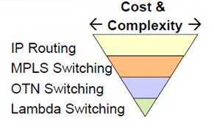

Optimizing bandwidth with switching
What type of Switching?
Optical (Lambda) Switching
Digital (OTN) Switching
Grooming at λ level only
Granular Grooming at service level
Wavelength, λ
Wavelength, λ
ROADM
Digital Switch
Fiber
Fiber
Service
stays within the same λ, in Wavelength Switch
Service
packed in OTN containers, groomed in Digital Switch
10G λ
Line
100G, 500G λ
Line
1T λ
Line
Good when Service = Line
≤ 10G Services
Good when Service < Line
≤ 10G Services
≤ 10G Services
Source: Cost Pyramid- ECOC

Slide 20
What if there’s no digital switching in the network?
1
Simple 8 node network
Demands from only 1 node
10G Services, 100G Transport
3 λs total,
each with 20 or 30% fill
2x10G Svc
3x10G Svc
2 λs total,
each with 20% fill
2x10G Svc
A
B
C
D
3x10G Svc
2x10G Svc
F
G
H
E
2x10G Svc
Transport Node
Muxponder, ROADM
Notes:
Let’s examine what happens if there’s no digital switching and we use only optical (or lamdba) switching with Muxponders / ROADMs.

Slide 21
What if there’s no digital switching in the network?
2
Simple 8 node network
Demands from only 1 node
10G Services, 100G Transport Adding 1x10G service
4 λs total,
each with 10, 20 or 30% fill
2x10G Svc
1x10G Svc
3x10G Svc
3 λs total,
each with 10 or 20% fill
2x10G Svc
A
B
C
D
3x10G Svc
2x10G Svc
F
G
H
E
2x10G Svc
1x10G Svc
Transport Node
Muxponder, ROADM
Notes:
Let’s add a 10G service between 2 nodes
We need to add an individual wavelength or lambda between those 2 nodes
Thus we see the fill of network is quite less making it inefficient.

Slide 22
Digital switching at each node optimizes bandwidth use
3
Simple 8 node network
Demands from only 1 node
10G Services, 100G Transport
Better use of fiber
1 λ total,
with 80% fill
2x10G Svc
1x10G Svc
3x10G Svc
1 λ total,
with 50% fill
2x10G Svc
A
B
C
D
3x10G Svc
2x10G Svc
F
G
H
E
2x10G Svc
1x10G Svc
Switching & Transport Node
Notes:
Digital switching boosts the fill ratio, improving overall efficiency of the network

Slide 23
What if resiliency is needed (w/ no digital switching)?
4
Simple 8 node network
Demands from only 1 node
10G Services, 100G Transport 1+1 Protection
2x10G Svc
1x10G Svc
3x10G Svc
3 λs total,
each with 10, 20 or 30% fill
2x10G Svc
A
B
C
D
3x10G Svc
4 λs total,
each with 10, 20 or 30% fill
2x10G Svc
F
G
H
E
2x10G Svc
1x10G Svc
Transport Node
Muxponder, ROADM
Notes:
Now, let’s see if we need to protect paths for each service demand….actually this is almost always a customer requirement….
The number of wavelengths start multiplying, increasing inefficiencies.

Slide 24
Digital switching at each node optimizes bandwidth use
5
Simple 8 node network
Demands from only 1 node
10G Services, 100G Transport
Better use of fiber
2x10G Svc
1x10G Svc
3x10G Svc
1 λ total,
with 60 % fill
2x10G Svc
A
B
C
D
3x10G Svc
1 λ total,
with 80% fill
2x10G Svc
F
G
H
E
2x10G Svc
1x10G Svc
Switching & Transport Node
Notes:
With digital switching we use network resources more efficiently…..

Slide 25
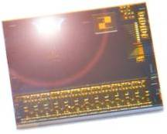
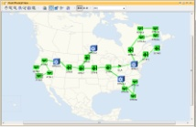


Layer on GMPLS to simplify Services Delivery
Digital Optical Network
Digital
Everywhere
+
Intelligent GMPLS
Automation
1001
0101
0101
1010
1101
0101
0101
1010
1101
0101
Networks deployed in days
Services deployed in minutes
Mesh protection in milliseconds
Notes:
The DTN-X brings the easiest to use network by marrying the digital nature of the PICS with intelligent GMPLS Automation to deliver the digital optical network. Because there are many nodes with digital way points where we are doing optical-electrical-optical conversions, GMPLS enables the network effectively to become self aware so every node knows what the other is doing – how much bandwidth is available, what slots and ports are in use, backup paths available -- and the DNA network management system in turn knows what all nodes are doing.
Click
This ease-of-use enables our networks to be deployed in days instead of weeks or months
Click
And it enables services to be deployed in minutes. The customer simply pulls two TAMs from stock or orders them from Infinera, plugs them in and then point and click provisions between the two nodes.
Click
In addition the system delivers mesh protection < 50 ms. It does this by continuously dynamically calculating backup paths and then storing those back up paths in a high speed hardware based lookup table.
This ease-of-use and ability to deploy networks and services faster than their competitors is something that our customers loved about DTN and that we are now scaling onto DTN-X. On that note, I’d like to take this opportunity to invite one of our customers up to the stage, Randy Nicklas, CTO of XO communications.
Click
Welcome Randy. Randy, you’ve been a long time customer of Infinera so why don’t you tell us a little bit about XO, how you use the DTN and if you care to share your thoughts on DTN-X.
Click

Slide 26

Fundamental network integration needs
De-layering
Status Quo
SP Network
Phase 1
what THE NETWORK will be
Phase 2
IP
Route
IP/MPLS
IP/MPLS
Services
MPLS
Switch
PIC
Enabled
OTN
SDH
SONET
PIC
Enabled
DWDM
Converged
MPLS/OTN/DWDM
(future)
Transport
Converged OTN/DWDM
Notes:
Now this innovation is fundamentally improving customer networks . On the left hand side we can see the way many networks are deployed today with a IP/MPLS router layer, a SONET/SDH/OTN switching layer and a DWDM transmission layer.
Click#1
Today and for those customers who deployed DTN we are enabling the convergence of the DWDM and switching layer. This reduces the number of boxes and interconnections between boxes and therefore reduces maintenance, power, space, cooling and operating costs.
Click#2
In this first phase we are seeing another trend in the industry where service providers are insisting that router vendors separate the MPLS switching function from the IP services function. This is because in the core of the network MPLS is used as a transport function, only used to carry services not to create services. One of the key drivers for carriers to rethink their networks is the huge cost of high capacity router ports – particularly 40G and 100G ports. This is causing carriers to rethink how they design their networks – with the desire to push more management of the network in the optical layer (where the management cost per bit is less).
Now an operator can converge to a simple two layer network model with the DTN-X performing all of the transport functions of DWDM transmission, OTN switching and MPLS switching minimizing network complexity and further reducing the number of boxes and capex and opex costs. The DTN-X is designed to do all three of functions in any mix in a completely non-blocking fashion without compromise. Let’s looks at how it stacks up.
Click

Slide 27
Integrated digital OTN switching delayers the node
More Power, Space, Cooling, Operations needed
Less devices, Faster provisioning. Further miniaturization with Photonic IC (PIC)
Route
IP, MPLS
Device proliferation
Integrated Transport & Switching Chassis
External Interconnects
Switching chassis
Switch
OTN, SDH, SONET
Transport
DWDM
Transport chassis
Functional Layers
Node Architecture 1
Node Architecture 2
Notes:
Integrated digital switching per node brings tremendous network efficiencies as we saw in the 8 node case study.
However there are different ways to implement this technology.
One approach is by using an External Switching Chassis to the Transport one…this needlessly increases power, space, cooling, operations
A better approach is by using an Integrated Transport & Switching chassis.

Slide 28
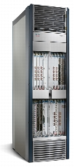
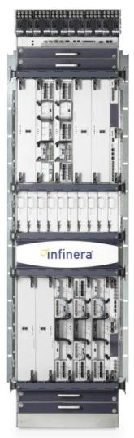
Integrated MPLS switching further delayers the node
Full-function IP core router requirements
Packet-Transport Requirements
MPLS(-TP) midpoint LSR functionality
Pseudowires: high speed Ethernet services
Single core for multiple service networks
Core routing protocols
Modestly sized IP forwarding tables
Forwarding based on millions of IPv4/IPv6 routes
Filtering: Line Rate Packet Filtering, Reverse Path Filtering, Millions of ACLs, Multi-stage filtering
General Internet BGP routing: Large # EBGP peers, 10’s millions learned paths, complex routing policies, route reflectors, confederations, Outbound Route Filtering (ORF) Extensions
Legacy interfaces: PPP, ATM, Frame Relay, T1/T3, channelized SONET/SDH, etc.
VPNs: L3VPNs, L2VPNs, T1 CEM, VPLS
Provider Edge functionality: LDP PE, PWE for legacy interfaces (ATM, FR, low-speed TDM)
Deep buffering: 150ms or more of buffering.
Large number of ACLs (100,000’s firewall filter terms)
Large number of queues and complex scheduling. (Hundreds of thousands of queues)
Large IP routing/forwarding tables. (Millions of routes)
Generic IP encapsulations (GRE, L2TP)
Core routing protocols: OSPF(-TE), ISIS(-TE), LDP and/or RSVP-TE, P2P and P2MP LSPs
Core
IP/MPLS
MPLS-TP
DTN-X
Efficient form-factor
WDM, OTN, MPLS
Customers need converged cost-effective L0/1/2.5
Notes:
Now we saw various layers of switching in the famous inverted pyramid image.
Taking the concept of integration further to the MPLS layer, we see Core IP/MPLS devices boast several features that add to complexity and cost.
The need for a Transport and Core MPLS device is to use an optimized set of protocols that can be best achieved as shown here in an integrated WDM, OTN and MPLS switching device like the Infinera DTN-X

Slide 29
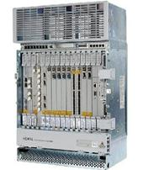
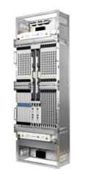
Convergence Without Compromise
Infinera DTN-X
Next-Generation
P-OTN System
Without Compromise
Core
MPLS Switch
DWDM
Transport
OTN
Switch
No performance limitations
No loss of rich WDM management when adding IP
No loss of WDM capacity when adding OTN switching
Notes:
The key here is to converge without any performance compromise

Slide 30
Business challenges
Network challenges
Boosting network efficiency
Enabling customer success
Notes:
Let us now step back to discuss why we are here today- the industry challenges, the need for radical innovation and how Infinera wins.
Click

Slide 31
Helping scale bandwidth, not network TCO
Forecasted business growth & TCO impact. Everything converted to Opex, including Capital (7 years).
Tier 1 Operator in 2009
Expected Cost* Evolution for Bandwidth
International DWDM Systems
100%
80%
60%
40%
20%
Historical: ~60%
Capex was only 30% of TCO
Projected: ~20% did not meet carrier’s needs!
Looked for 50% TCO reduction
* Cost = Total Cost of Ownership per Gbps
With Infinera achieved 70% TCO reduction
2003 2005 2007 2009 2011 2013 2015
Source: Tier 1 Operator
Notes:
Now as network bandwidth needs to scale, its rather obvious that network costs don’t have to
Here’s an example of how a Tier 1 operator tackled that challenge in 2009
Faced with the need to evolve bandwidth, this operator first calculated historical costs vs. bandwidth
And then projected it for the next 5 years looking for 50% TCO reduction
He realized capex was only 30% of the TCO and it was really opex that drove total costs

Slide 32
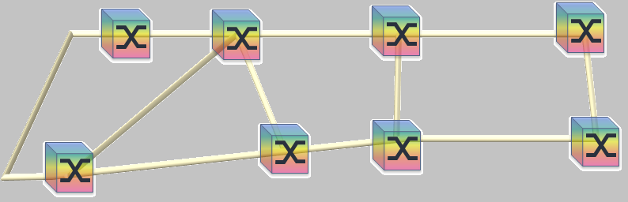
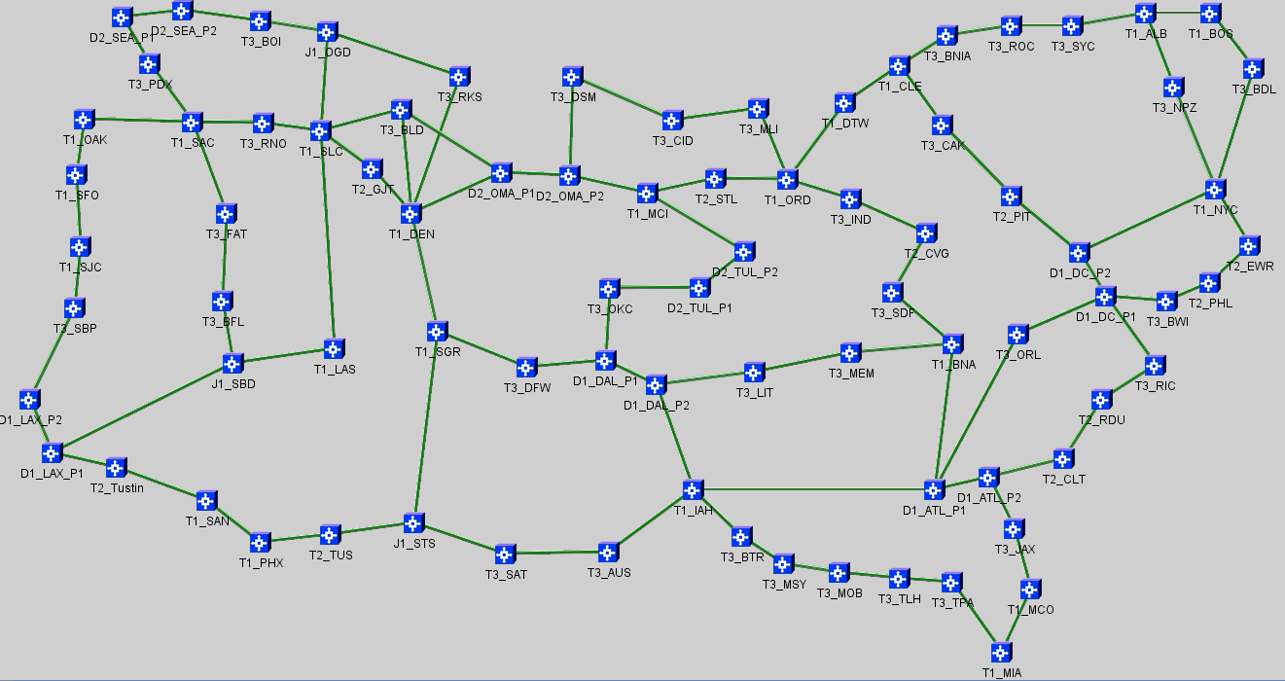


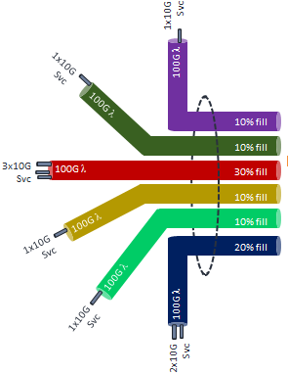
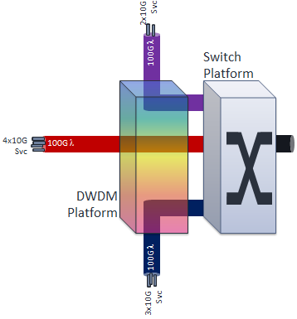
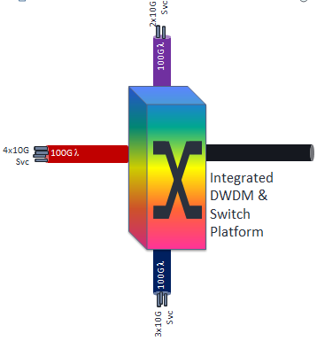
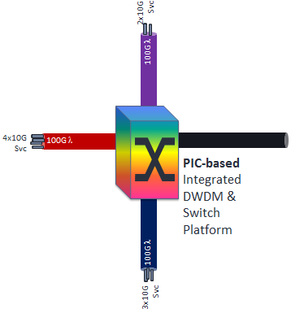
Modeling a real network across 4 architectures
Extrapolating the 8 node model to real networks
Large Pan North American network with average 50% utilization
Sep 2011
Srinivasan Ramasubramanian
Suresh Subramaniam
Satyajeet Ahuja, Steven Hand
Muxponders
(Non Switched)
External Switching
Integrated Switching
Integrated Switching
with PIC
Notes:
The proof of the pudding is in the eating and we compared various architectures extrapolating the simple 8 node example to a real-life network with 80 nodes.
Two university professors along with Infinera examined 4 architectures including
Muxponders (Optical switching only)
External Switching (using separate chassis for Transport and Digital Switching)
Integrated Switching (one chassis for Transport and OTN but without using PIC)
Integrated Switching using the PIC

Slide 33
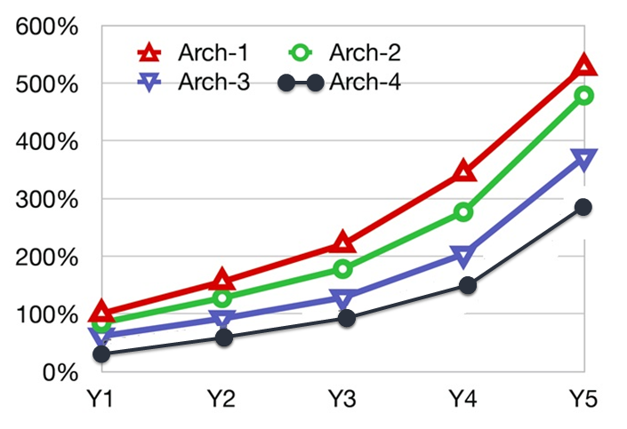
Network lifecycle costs measured
Large Pan North American network with average 50% utilization
Muxponder
Ext. Switch
Int. Switch
Int. PIC-based
Network
Costs
Highest Economic Value
Time
Source: Multi-year TCO Analysis- University of Arizona, George Washington University, Infinera
Notes:
The results bear ample proof of the value of integrated switching, with the highest economic value being realized by the use of the PIC technology.

Slide 34
Operational benefits add up → Investment longevity
Power
Rack Space
More Scalability
Less Power
Less Space
Lower TCO
50% less
33% less
200%
150%
100%
100%
4D Junction; 1T/degree; 25% Add/Drop
Capacity
# Chassis
568
67% less
~2-3X more
~250%
100%
189
# Modules/Cards
Total Costs
9,770
69% less
225%
56% lower
3,024
100%
Source: University of Arizona, George Washington University, Infinera

Slide 35
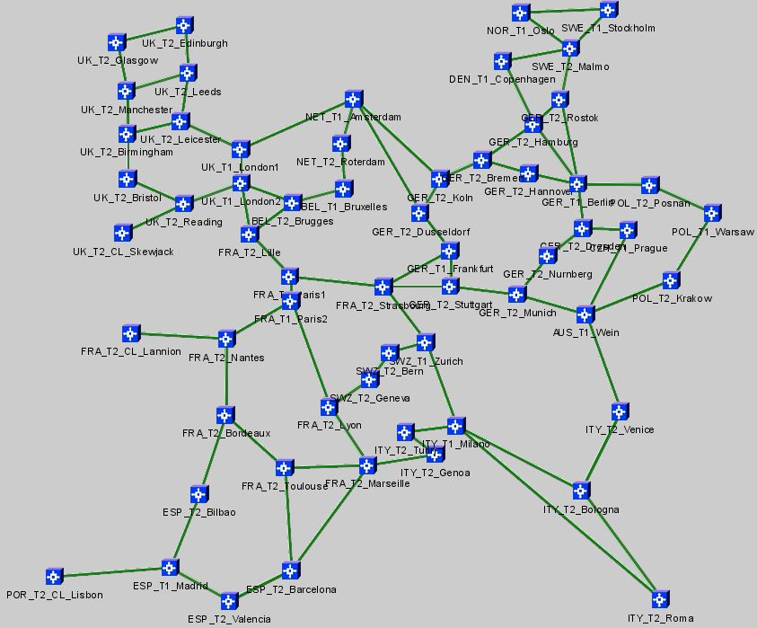
Modeling a Pan-European Long-Haul Network
26,629 km fiber network
58 total add/drop nodes
  6 data centers
  2 Dual POP sites (London, Paris)
  15 Tier 1 cities
  43 Tier 2 cities
  238 optical line amplifier sites
Representative of typical long-haul network
  “Carrier’s carrier” service provider
  Tier 1/PTT long-distance international network
Fiber Type | Fiber Distance (km) | Number of Spans
E-LEAF | 17689 | 215
Silica Core | 486 | 3
SMF28 | 7826 | 93
TWRS | 627 | 8
Total | 26629 | 319

Slide 36
OpEx due to Power: 10-year cost
Power OPEX ($)
$40-50M less spending on power
40% Less
Network Greening
$140 Million
$120 Million
$100 Million
$80 Million
Y10
$60 Million
Y5
$40 Million
$20 Million
$0
Competitors
Integrated Switching
Services
over waves
DTN-X
Reference:
Pan-European LH network
$0.2/kW-hr used in computation

Slide 37



Record of delivering quality & customer success
Randy Nicklas
CTO XO Communications
“We have used DTN as a competitive advantage to simplify our network, deploy services faster and increase bandwidth efficiency, we are looking forward to the new DTN-X platform that will help scale these qualities while delivering the same ease of use that XO has grown accustomed to from Infinera.”
Matthew Finnie
CTO Interoute
“Interoute successfully exploited the previous generation of PIC technology revolutionizing how high capacity services were delivered in Europe. We look forward to the DTN-X as the next evolution of the model that has consistently demonstrated cost and operational efficiency.”
Stu Elby
Vice President of Technology
“Our growth is continually driving the need for greater integration and efficiency within the network. Innovations such as Photonic Integrated Circuits that enable terabit scale while adding efficiency with integrated transport and switching will be essential to extracting long term economic value as the network scales to hundreds of terabits.”

Slide 38

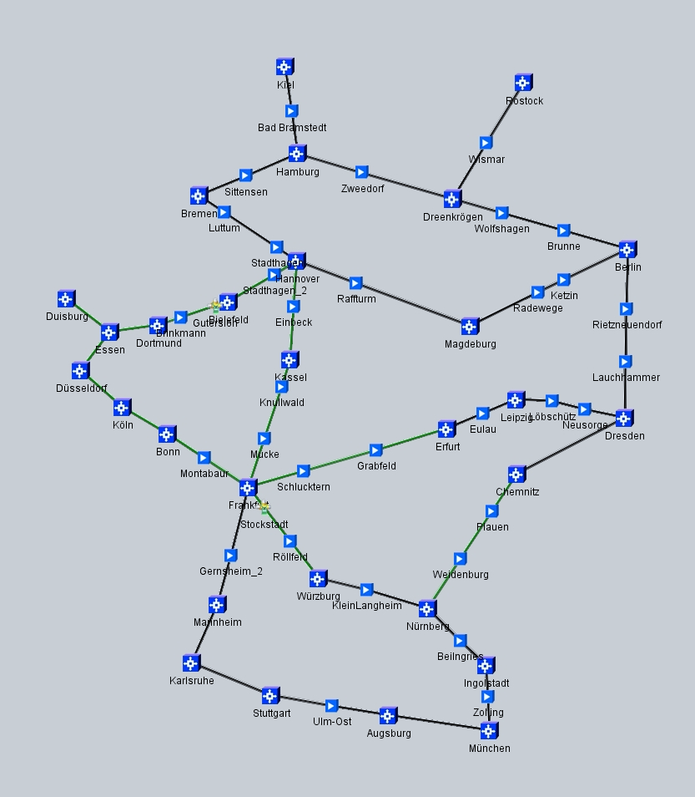


Efficiency without compromise
Powered by Integrated Switching using PICs
High Bandwidth
Bandwidth needs keep growing → efficient opex & capex needed
Integrated Switching
Muxponder
Integrated Switching optimizes & delayers the network, speeds up service provisioning
Point to Point Architecture
Highly Meshed Architecture
Over 25% better TCO helping balance growth & costs
Initial build
Low Bandwidth
Network Total Cost of Ownership (TCO)
Source: Multi-year TCO Analysis- University of Arizona, George Washington University, Infinera

Slide 39
http://www.infinera.com

