Slide 1
The Multi-Service IP Network for Railways
Felix Gerdes
Business Development
Rail Transport & Mass Transit, EMEA
International IRSTE & IRSE Convention, New Delhi, 28 April 2012

Slide 2
Agenda
The Opportunity for Further Progress
Coming: The Cost Avalanche
IP for Trackside Comms: Achieving Reliability
The Cisco
Connected Signalling Architecture

Slide 3
A Way Forward
Remove Technology Barriers
Adapt the Business
Achieve Growth, Prosperity
Look Familiar?
Example: Reliable, high capacity data and voice networks from the US to India gave birth to the BPO industry.
From The World is Flat, Thomas L. Friedman

Slide 4
Implication of Mega Corridors in India
8 Mega Corridors by 2021
  Delhi – Mumbai Industrial Corridor: 204m
  Mumbai – Ahmedabad Corridor: 58m
  Bangalore – Belgaum: 38m
Commuter & Freight Rail Transport Growth
will be Imminent
Source: Frost & Sullivan, Mega Trends in India: Macro to Micro Implications of Top MegaTrends in India to 2020, Sarwant Singh, Archana Amarnath, 02 Feb 2012

Slide 5
A Possible Way Forward
RailTel: a service provider for Indian Railways,
local government and businesses across India ...
RailTel rolls out ETCS Level 2
RailTel delivers train control comms as a another service

Slide 6
Challenges Facing Railway Managers
Increasing Focus on the Customer
More Competition (Inter- and Intramodal)
How to Win and Retain Customers?
Safety & Security are Top of Mind
Safe Environment for Passengers and Staff
How to Reduce Interruptions and Delays?
Better Utilisation of Assets
Facilitate more train movements
How to Improve Reliability and Reduce Downtime?

Slide 7
Agenda
The Opportunity for Further Progress
Coming: The Cost Avalanche
IP for Trackside Comms: Achieving Reliability
The Cisco
Connected Signalling Architecture

Slide 8
Railway Infrastructure Operators and Telecom Providers
Railway
Infrastructure Operators
Nation-wide fibre-optic networks
Need to provide
very-high availability
of services
Telecom Providers
Extensive fibre-optic networks
Need to provide
very-high availability
of services
Some important similarities

Slide 9
Railway Infrastructure Operators and Telecom Providers
Railway
Infrastructure Operators
Beginning to explore the possibilities of new network technologies
Telecom Providers
Have migrated from ATM / TDM over SDH to higher capacity design of Ethernet and IP
And one major difference

Slide 10
Railway Infrastructure Operators and Telecom Providers
Why telecom providers have migrated to IP
The Facts:
100% of the world’s 25 largest telecom providers have migrated to Ethernet and IP
Most telecom providers will stop investments in SDH by 2010 at the latest
By focussing on IP, 69% of telecom providers expect savings from 11% to over 50%
Source: Infonetics Research, Service Provider Plans for Packet Optical Transport and 40G, Oct 2008

Slide 11
Railway Infrastructure Operators and Telecom Providers
What this
means to you
Major Purchasers
of SDH Depart
SDH Now Effectively at
End-of-Life
Spare Parts,
Skills Become Rare and Expensive

Slide 12
Railway Infrastructure Operators and Telecom Providers
How will
you increase operational
efficiency and still innovate and grow the business
What this
means to you
Major Purchasers
of SDH Depart
SDH Now Effectively at
End-of-Life
Spare Parts,
Skills Become Rare and Expensive
?

Slide 13
Agenda
The Opportunity for Further Progress
Coming: The Cost Avalanche
IP for Trackside Comms: Achieving Reliability
The Cisco
Connected Signalling Architecture

Slide 14
Is an IP Network Reliable Enough for Railway Telecoms?
Like my Internet at Home?
How will we deal with Hackers?
?
Signalling data behind ...
... a slow iTunes download?
?
?

Slide 15
IP Networks for Signalling and
Train Control
IP was developed for defence applications
Development of TCP/IP began in the early 1970’s, at the U.S. Defence Advanced Research Projects Agency (DARPA)
Main driver for this communications protocol was to control nuclear armaments under severe conditions
IP is a “connection-less” protocol; it is assumed that the physical network is unreliable and subject to failure

Slide 16
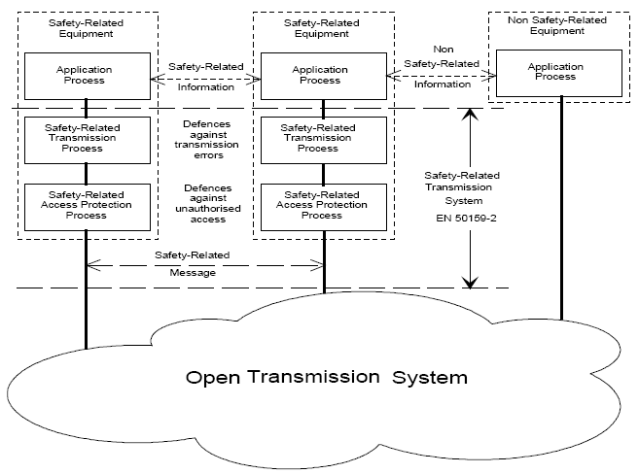
CENELEC 50159-2 Railway Standard
Open Transmission Network (SIL 0)

Slide 17
Achieving Survivability of the Network
Characteristics* | Applied to the IP Network
Hardness resistance to deformation | Robust, proven products with very high measured MTBF
Stealth ability to conceal itself | Network security to restrict access and counter intrusion
Redundancy duplication of critical system components | Redundant paths, devices, fans, power supplies
Diversity variation of systems; mitigation of fragility in changing conditions | Fast convergence to meet or exceed the performance of SDH; QoS to prioritize traffic under changing conditions
* From Defining Survivability for Engineering Systems, by M.G. Richards, D.H. Rhodes, D.E. Hastings and A.L. Weigel, MIT, March 2007.

Slide 18

Some of the Measures used to
Achieve Resilience
Mission-Critical Network Design
Redundancy: at Sites, in Components within the Devices, Redundant Links
Very High (measured) MTBF of Devices
Comprehensive Network Security Measures
Fast Network Convergence* (< 50ms)
* Ability of the network components to adapt to changes in topology, routing paths
Notes:
Survivability: The ability of a system to minimize the impact of a finite disturbance on value delivery achieved through either
the satisfaction of a minimally acceptable level of value delivery during and after a finite disturbance or
the reduction of the likelihood or magnitude of a disturbance
Resilience: The ability of a network to continue to provide and maintain an acceptable level of service in the face of faults and challenges to normal operation
Service-Level Definitions are a key design consideration!

Slide 19
Agenda
The Opportunity for Further Progress
Coming: The Cost Avalanche
IP for Trackside Comms: Achieving Reliability
The Cisco
Connected Signalling Architecture

Slide 20
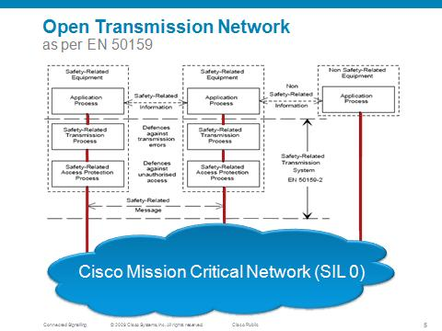
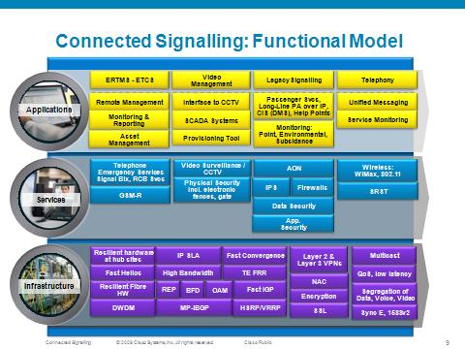
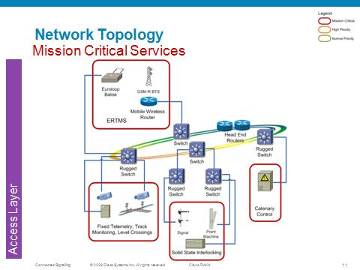
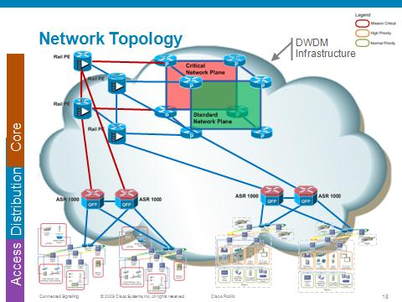
Architectural Approach to Addressing Business Needs
All components
EN 50121-4 compliant

Slide 21

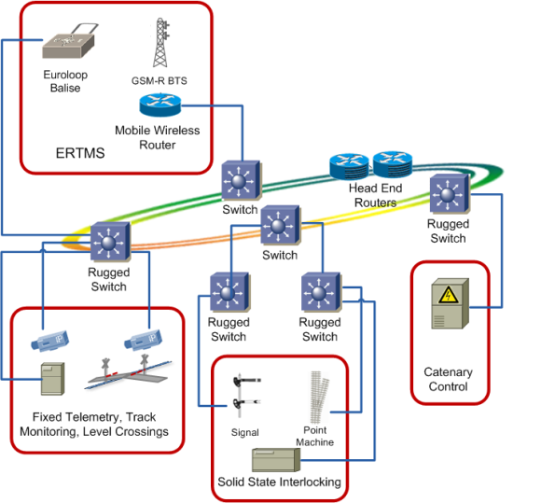
Network Topology
Mission Critical Services
Access Layer

Slide 22
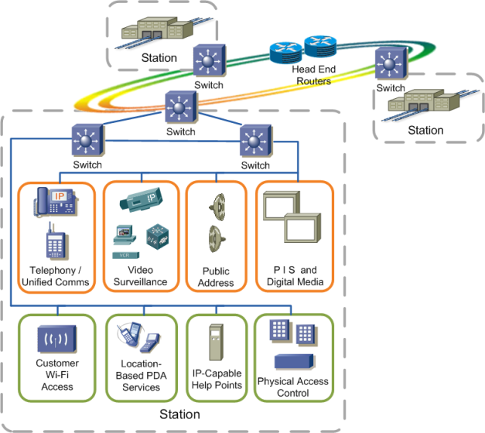
Network Topology
Standard Services
Access Layer

Slide 23
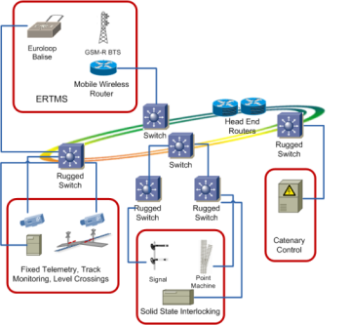

Network Topology
Mission Critical Services
Standard Services
Access Layer

Slide 24


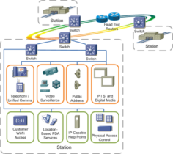

Network Topology
Mission Critical Services
Standard Services
Distribution
Access Layer

Slide 25


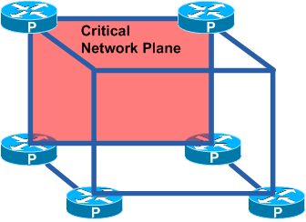






Network Topology
DWDM
Infrastructure
Core
Distribution
Access

Slide 26
Some Examples
Cisco IP MPLS network: delivers line side voice, monitoring and, soon, GSM-R backhaul at Rail Net Denmark
Cisco IP MPLS network: IP CCTV from 400 stations into centralised security operations and archives
Cisco IP MPLS network: Long Line PA into
more than 250 stations
Cisco IP MPLS network: GSM-R backhaul

Slide 27
Summary
Our Recommendations:
Avoid the “cost avalanche” associated with SDH – Act Now
An IP MPLS Multi-Service Network adheres to your standards, supports better utilisation of your assets
Design and build your telecoms network
for future needs

