Slide 1
International Convention on Modern Train Control, Delhi, 27th April 2012
Wireless technologies to improve operations, safety, security and drive revenue
ALVIN LIM | MOTOROLA SOLUTIONS (ASIA PACIFIC)
Notes:
TYPE TREATMENT
Headlines are Arial Bold 54pt, ALL CAPS, Black, white or gray type
Date: Arial 16pt, normal case, white type
Presenter information: Arial bold 18pt., ALL CAPS, Black, white or gray type. Paragraph Line Spacing is Exactly 0.9pt with 0pt spacing Before and After.
Headline and presenter type should be the same color.
HORIZONTAL BAR
Bar and Emsignia can be changed to any color in the Motorola Solutions color palette (see brand guidelines: www.motorolasolutionsbrand.com). Bar and emsignia should be the same color
Bar: Size: .49”H X 9.64”W. Placement: .17 Horizontal, 2.5 Vertical.
COLOR GUIDELINES
Only the colors from the Motorola Solutions color palette are acceptable (see brand guidelines: www.motorolasolutionsbrand.com)
Use only 1 color, plus black, white and gray
Do not use more than 1 color per slide
ADDITIONAL HELP
For additional informationPlease refer to the Motorola Solutions Guidelines: www.motorolasolutionsbrand.com
Be sure your Notes panel is open in PPT for information
and guidance throughout the document

Slide 2

Agenda
Wireless communication today
Wireless technologies - narrowband
Wireless technologies - broadband
Notes:
2
TYPE TREATMENT
Title is Arial Bold 32pt, ALL CAPS, Black, gray or color of the emsignia and colored bar on the cover slide
COLOR GUIDELINES
Only the colors from the Motorola Solutions color palette are acceptable (see brand guidelines: www.motorolasolutionsbrand.com)
Use only 1 color, plus black, white and gray
Do not use more than 1 color per slide
IMAGES: This area is reserved for imagery. All images are located on www.motorolasolutionscollective.com:
Images bleed on all 3 edges of the right side of slide
ADDITIONAL HELP
For additional informationPlease refer to the Motorola Solutions Guidelines: www.motorolasolutionsbrand.com
Be sure your Notes panel is open in PPT for information
and guidance throughout the document

Slide 3

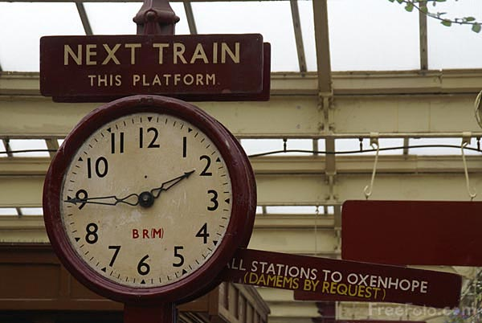
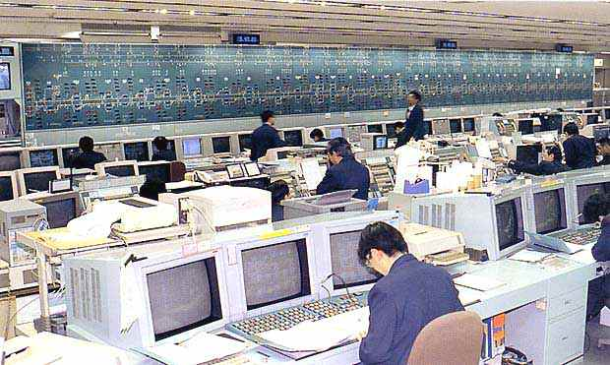
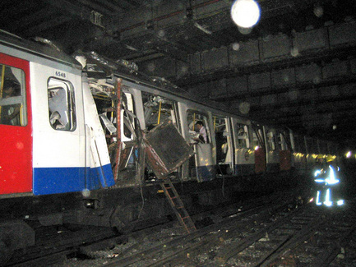
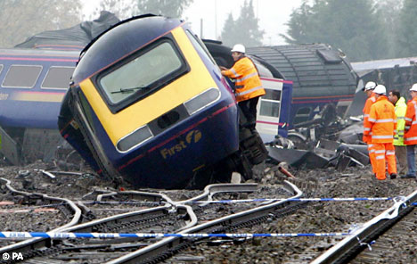
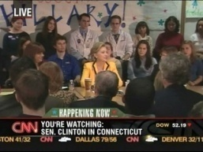
Market needs…
INTERNAL - OPERATIONS
Improve efficiency
EMERGENCIES
Improve incident response
Prevent incidents
Increase safety
Increase security
EXTERNAL - CUSTOMER
Customer satisfaction
Crew communications
Train monitoring and control – real-time telemetry
Fleet maintenance
Resilience, reliability, maintainability
Increasing line capacity (shorter headways)
CBTC / TCAS
Unattended Train Operations
Mobile workforce applications
Group communications & coordination
Remote diagnostics
Remote control in case of emergency
Passenger emergency communications
Information security
Platform-to-driver video
In-train CCTV surveillance - train-to-station/OCC video
Travel information
Advertisements
Location based services
  Infotainment - Multimedia Passenger information display
  Personal multimedia entertainment
In-train wi-fi – broadband internet access
3G/4G offload
How can wireless communication help?
Efficiency
Life cycle
Safety
Security
Experience

Slide 4







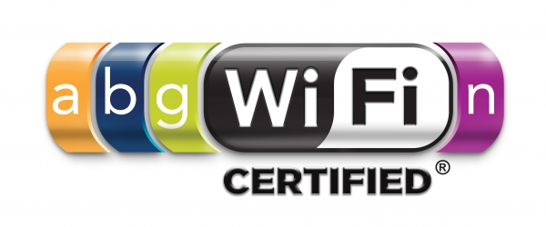
Wireless technologies today…
Narrowband
Wideband / Broadband
and much more…

Slide 5
Agenda
Wireless communication today
Wireless technologies - narrowband
Wireless technologies - broadband
Notes:
5
TYPE TREATMENT
Title is Arial Bold 32pt, ALL CAPS, Black, gray or color of the emsignia and colored bar on the cover slide
COLOR GUIDELINES
Only the colors from the Motorola Solutions color palette are acceptable (see brand guidelines: www.motorolasolutionsbrand.com)
Use only 1 color, plus black, white and gray
Do not use more than 1 color per slide
IMAGES: This area is reserved for imagery. All images are located on www.motorolasolutionscollective.com:
Images bleed on all 3 edges of the right side of slide
ADDITIONAL HELP
For additional informationPlease refer to the Motorola Solutions Guidelines: www.motorolasolutionsbrand.com
Be sure your Notes panel is open in PPT for information
and guidance throughout the document

Slide 6
Wireless technologies today…
Narrowband

Slide 7
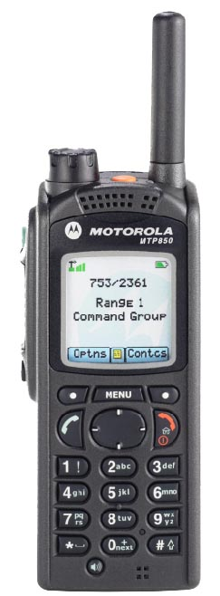
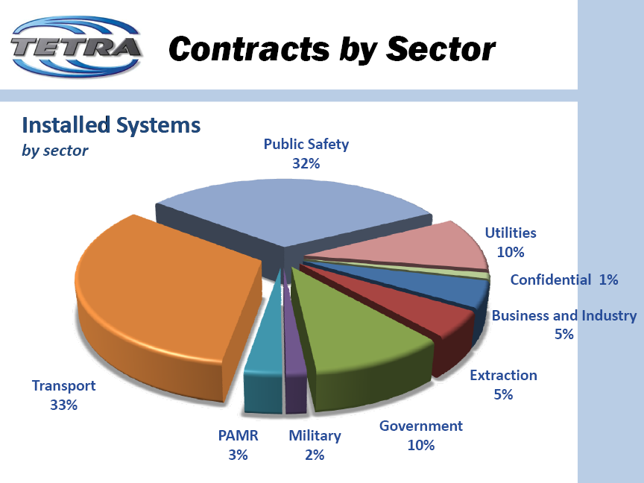
TETRA
The Standard
  Developed by ETSI
  Open digital standard
  TETRA feature set for mission critical users
  Spectrum efficiency
Dispatch service
Security
Telephone inter-connect
Safety
> 2k contracts across 114 countries
Advanced features
Data
Source: TWC2010

Slide 8
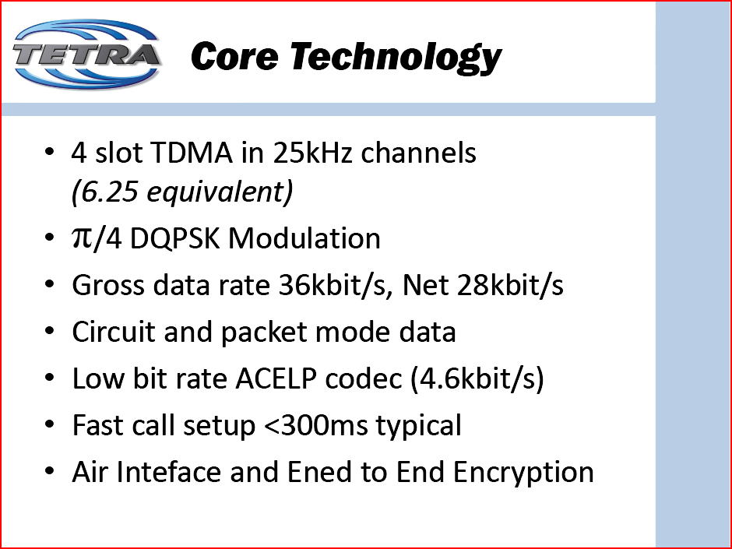
Frequency.
TDMA
1
2
3
4
1
2
3
4
25 kHz
channel
Time
28.8kbit/s
Air Interface and End-to-End Encryption

Slide 9
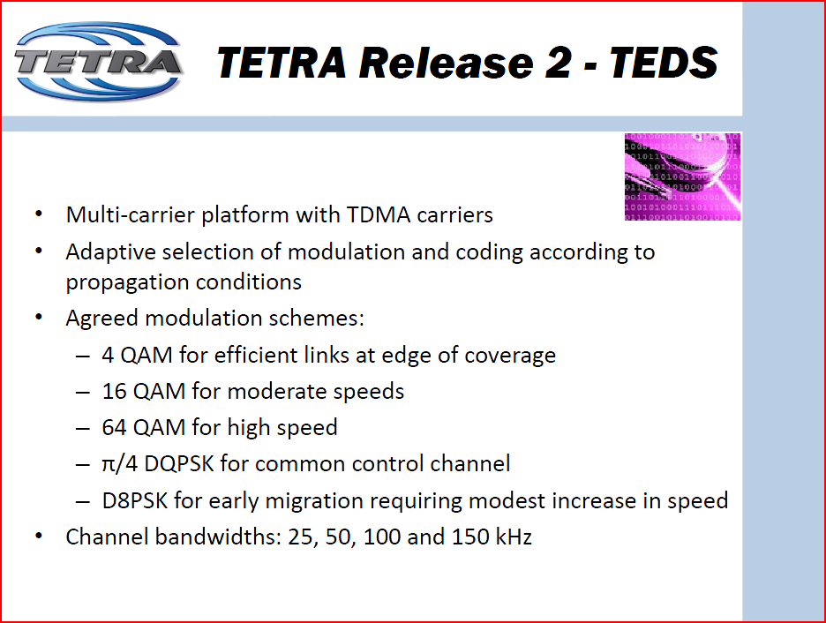
Packet data throughput (downlink): up to 400 kbps

Slide 10
Digital trunked radio evolution
Voice + SDS
PDS
MSPD
SCCH
TEDS
140 bytes
7.2 kbps
28.8 kbps
More SDS
100-400 kbps
Mission critical voice
Short data service
Packet data service
WAP
File transfers
Multi-slot packet data
Secondary control channel
TETRA Enhanced Data Service
GPS
Status monitoring
File transfers
WAP
Train telemetry
File transfers
Image transmission
Train telemetry
High SDS load for concurrent voice & data
FAO / UTO
3G equivalent
Video transfers
Early adopters
Copenhagen Metro, London Underground, Singapore NEL, SMRT, MTRC WR, DMRC

Slide 11
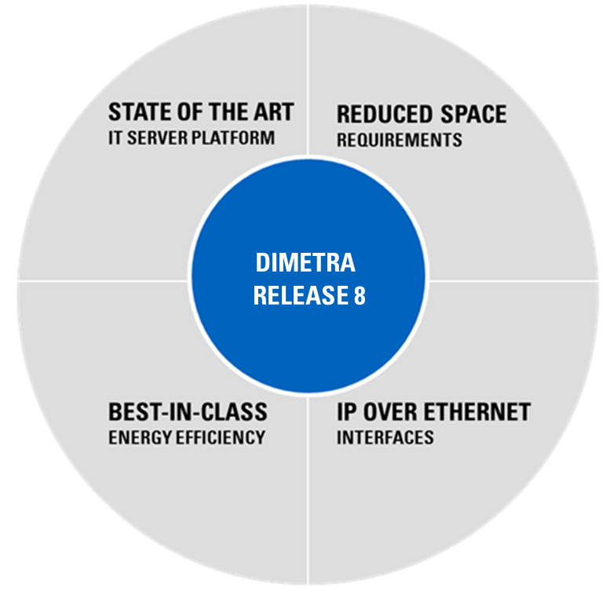
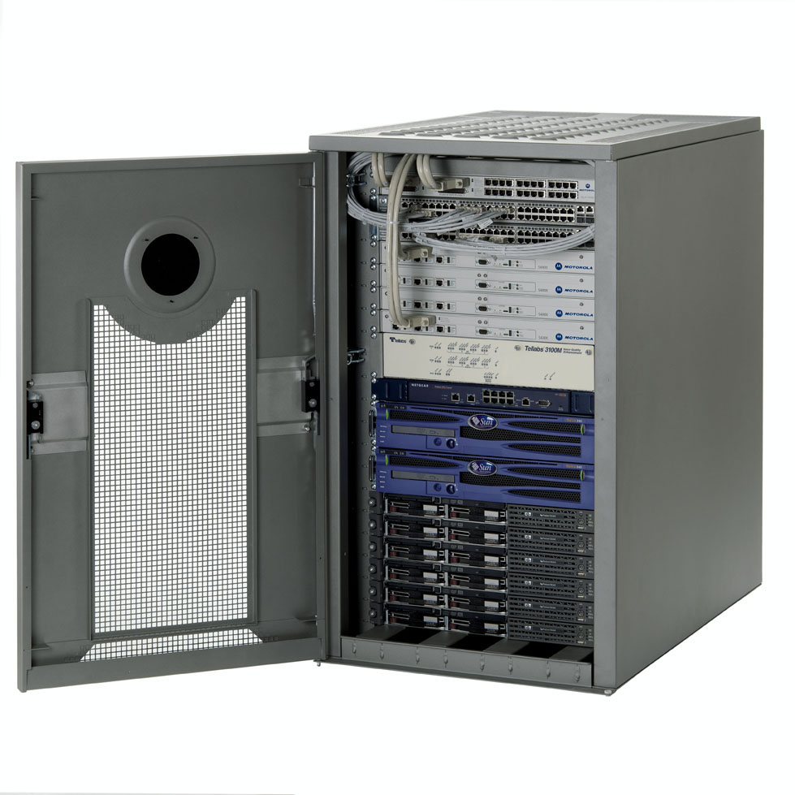
Motorola’s Dimetra IP radio system
Does a lot more with a lot less
REDUCED OPERATIONAL COSTS
Virtualised servers and all IP architecture enable cost effective operation and reduced space requirements
UNRIVALLED CAPACITY
State of the art IT servers enable exceptional levels of voice and data network capacity
Dimetra IP
INFORMATION ASSURANCE
A comprehensive set of advanced server redundancy options and improved link security
LONG TERM NETWORK EVOLUTION
Virtualised architecture decouples software from the hardware platform, simplifying long term support and network technology evolution
IT server virtualization
Low cost IP based transport
Energy efficient IT server platforms
→ Cost optimized high performance platform
Efficiency
Life cycle
Safety
Security
Experience

Slide 12

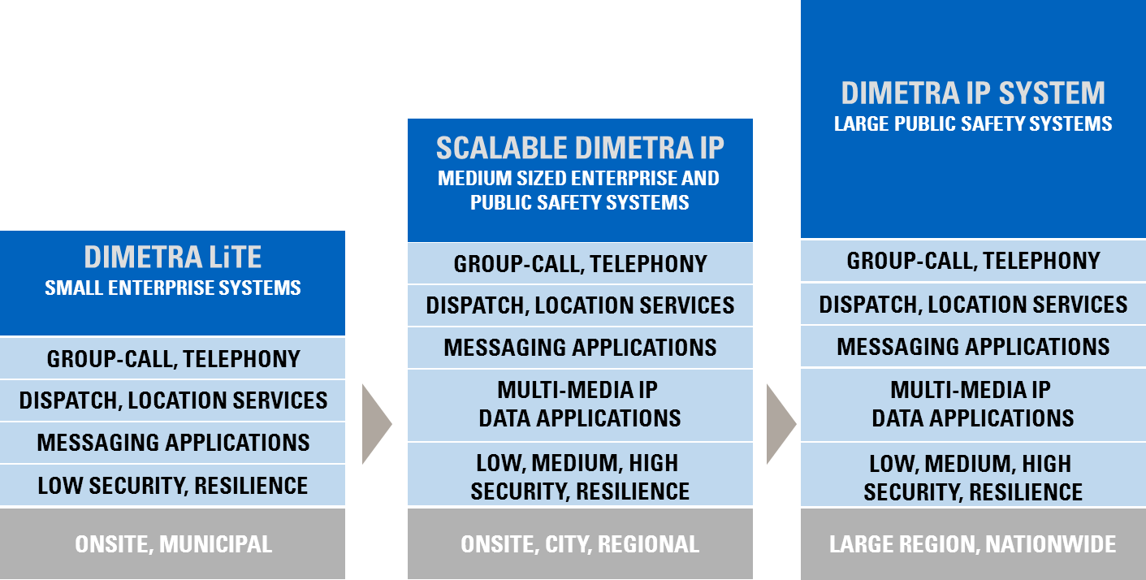
MORE CHOICES TO HELP YOU OPTIMISE YOUR INVESTMENT

Slide 13
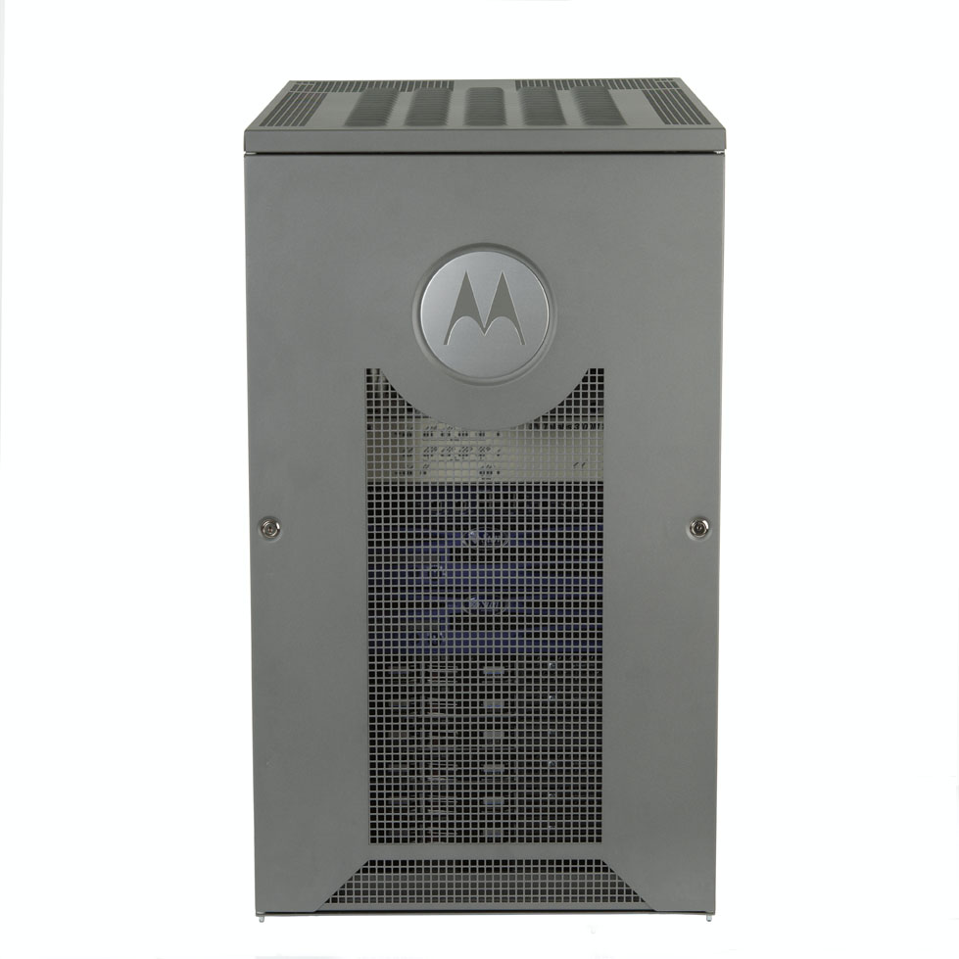
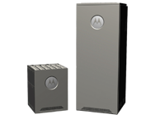
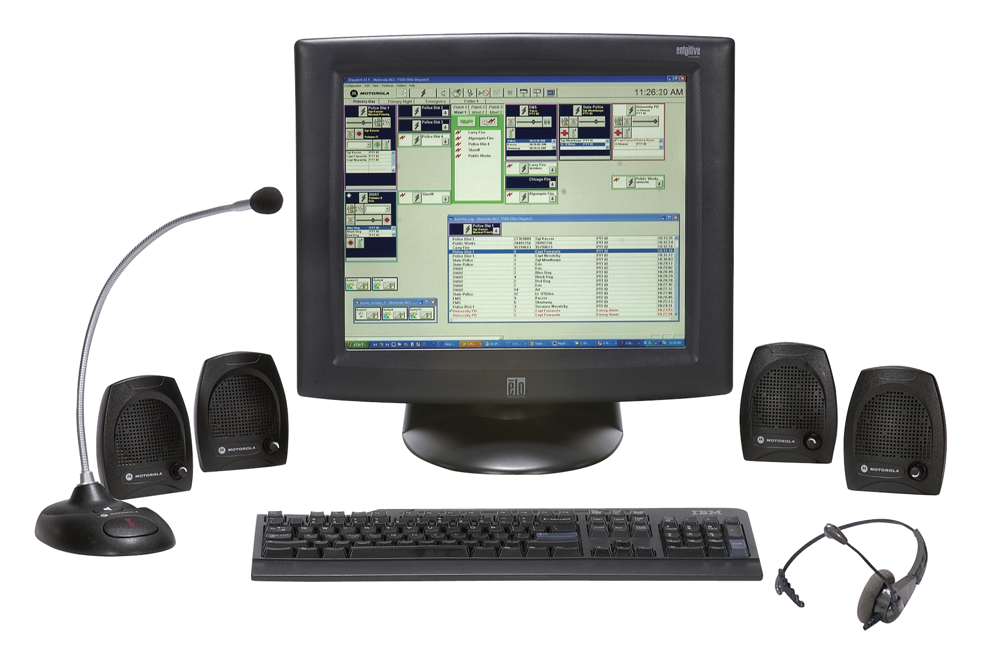
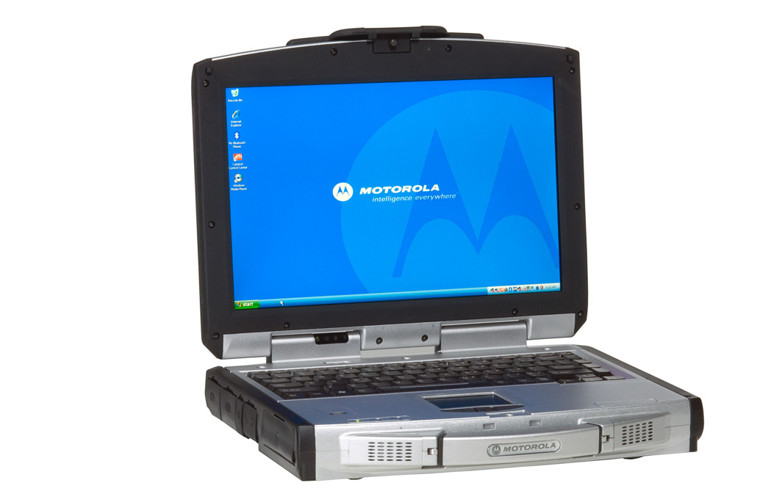
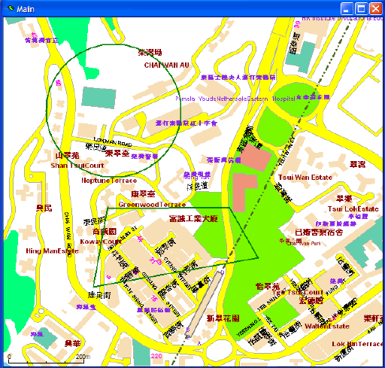
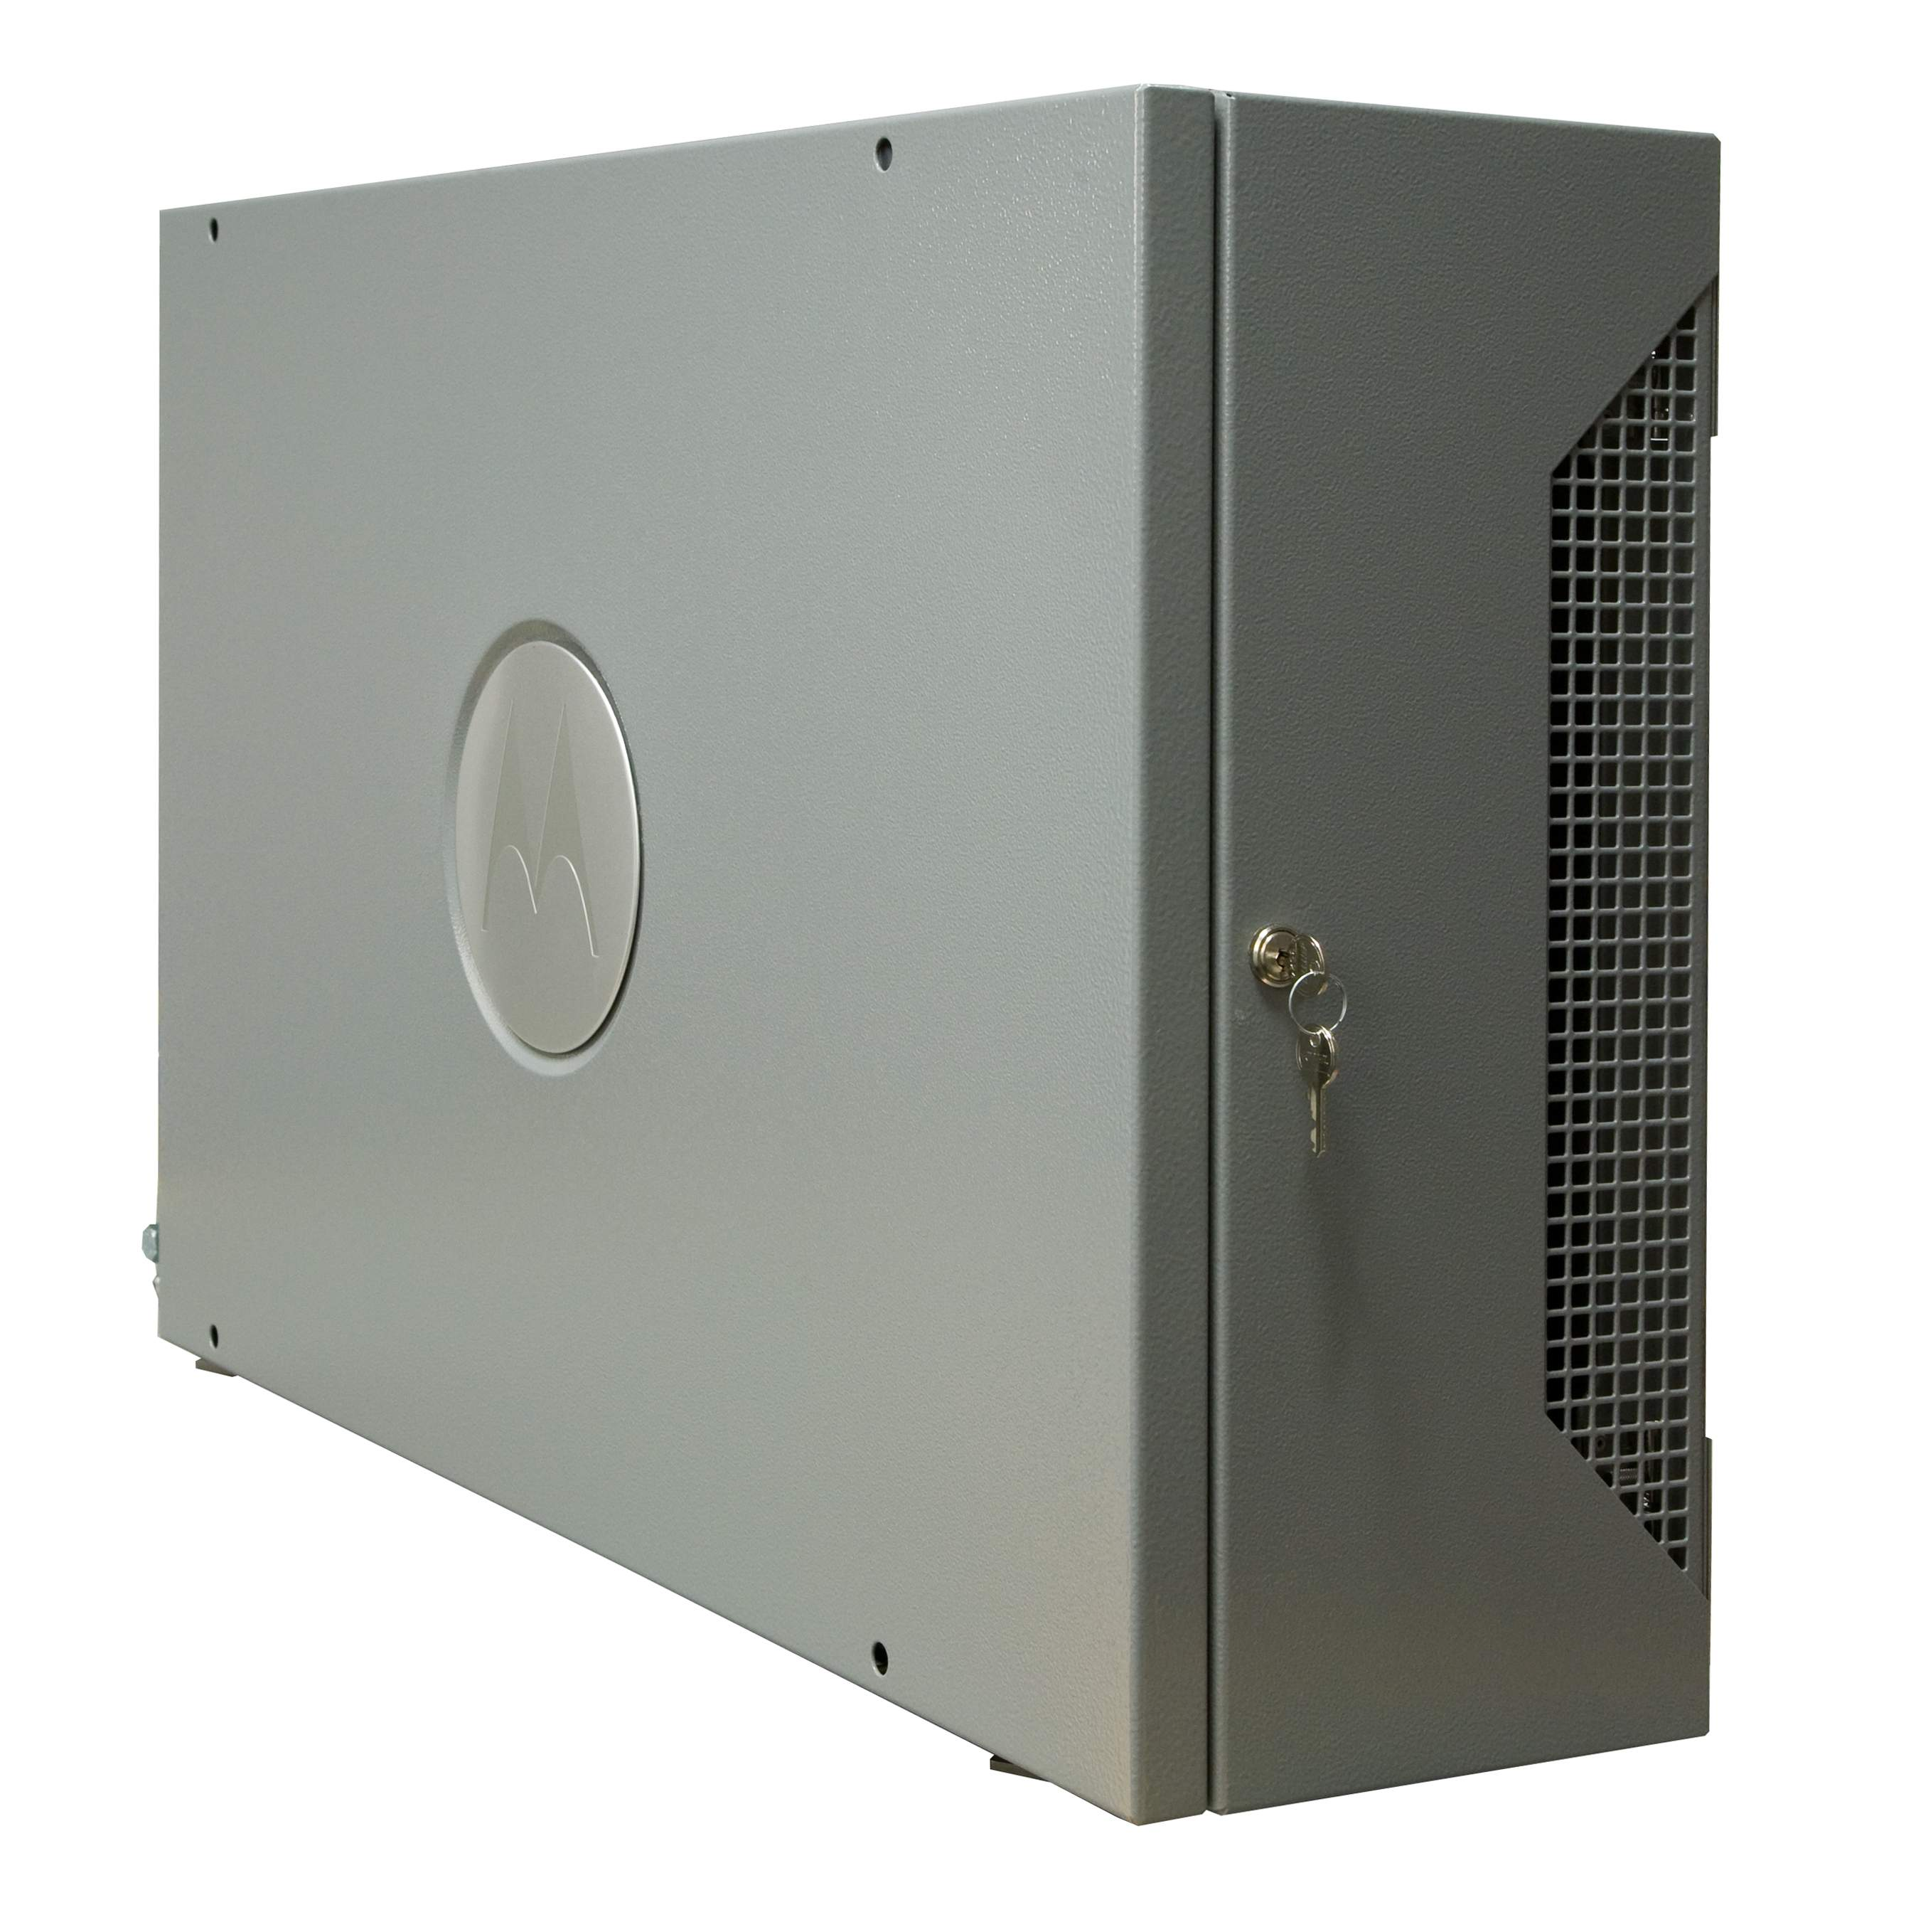

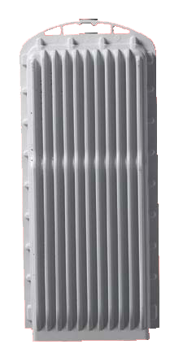
Motorola TETRA infrastructure portfolio
IP Core
Radio Access
Dispatch & Network
Management
Applications
Offering the most comprehensive scalability in features, capacity resilience and security
Meeting all customers needs in the most economical way
Complete suite of tested applications for voice and data created by application partners
Turning the system into an operation tool rather than just for communication
Supports the best RF performance coverage, resilience and maintainability
Offering customer valuable cost of ownership
An intuitive feature rich consoles and NM applications
Enabling ease and efficient management of the system, its users and the customer communication needs
Services
MOTOROLA and the Stylized M Logo are registered in the US Patent and Trademark Office.
All other product or service names are the property of their respective owners. © Motorola, Inc. 2009.
Motorola Commercial and Enterprise Portfolio

Slide 14
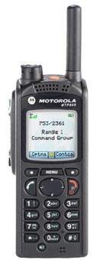


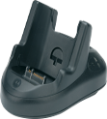

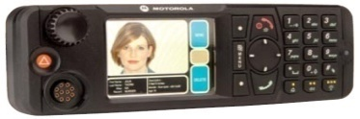
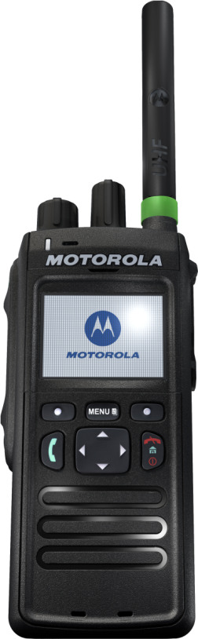

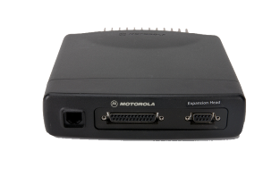
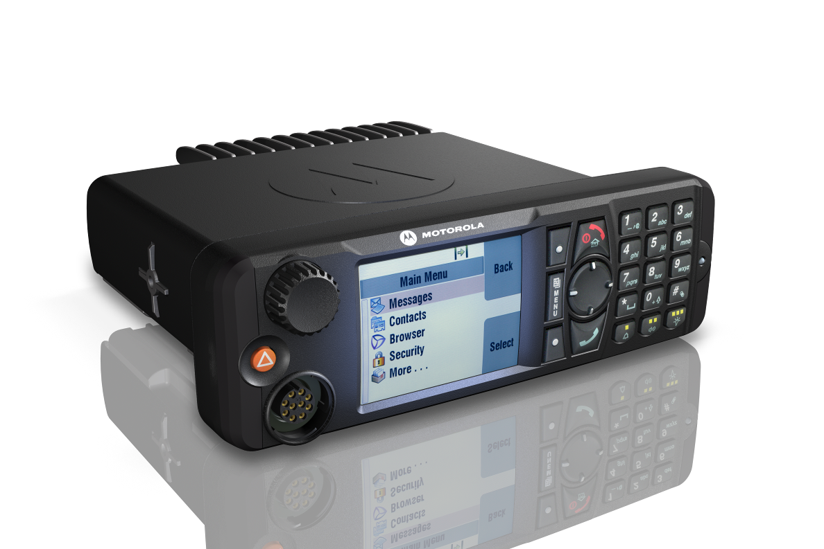
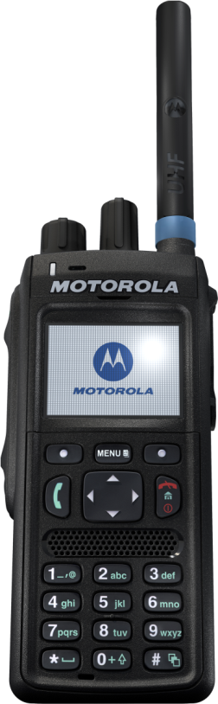
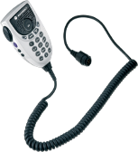
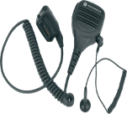
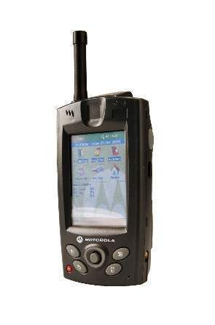
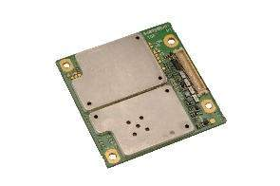
Motorola TETRA subscriber radio portfolio
Portable
Mobile
Accessories
Applications
MTP850EX
MTP850
Integrated Terminal Management
MTM800 Enhanced
Carrying
Energy
TCR1000
MTP3100
MTM800E data
MTM5400 GW/RPTR
Mobile
Audio
MTC100 PDA
MTP3250
TOM100 Modem
High Performance
Comprehensive, Proven Feature Set
Ease of Use
Common User Interface, Intuitive operation
Build To Last
Testing for real life operation is crucial
Tailored Solutions
Motorola + best in class vendors
Proven in Field
>1.5 million radios shipped, 80 countries
Platform Commonality
MOTOROLA and the Stylized M Logo are registered in the US Patent and Trademark Office.
All other product or service names are the property of their respective owners. © Motorola, Inc. 2009.
Motorola Commercial and Enterprise Portfolio

Slide 15
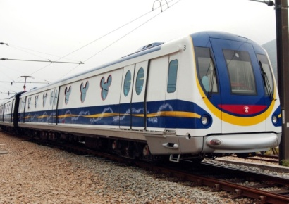
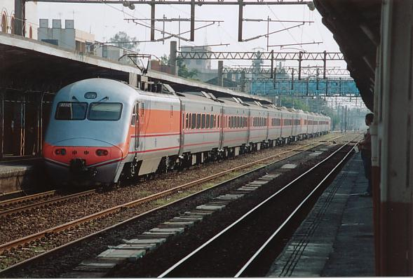
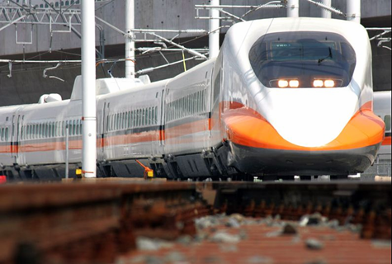
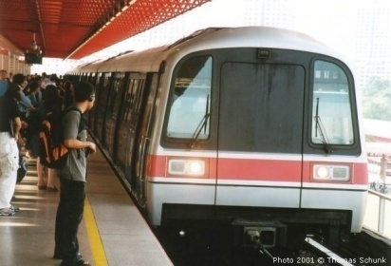
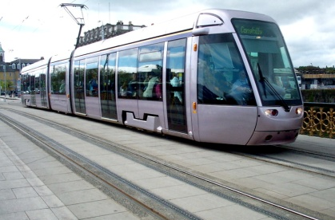
Rail/Metro Segment
TETRA is used from Light Rail to Long-haul Rail to High Speed Rail.
TETRA has been accepted as the de-facto technology for metro & subway.
FIRST in the world to operate TETRA for Rail → Malaysia ERL – supplied by Motorola.
FIRST in the world to implement TETRA for High Speed Rail → THSR at speed up to 350km/h – supplied by Motorola.
Light Rail & Trams
Long Haul Rail
High Speed Rail
Metro
Airport Express

Slide 16

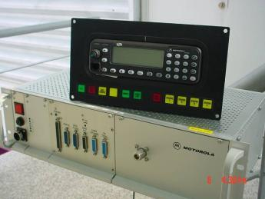
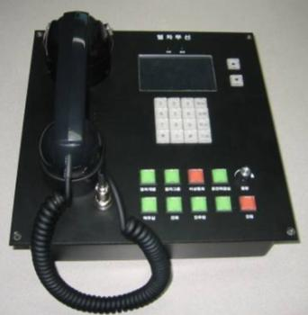
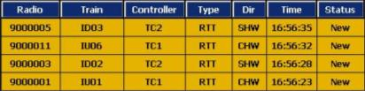
Why TETRA for rail
Open standard
  Interoperability with open interfaces
  Price Competitive
Digital
  Spectrum efficiency
  Good audio quality
Feature rich
  Mission critical features
  Instant group communications, secure, etc.
  Integrated / concurrent voice & data
  Full duplex individual call
Ease of operations
  Customized CAD for dispatcher
  Customized trainborne equipment
Interface to other railway sub-systems
  Passenger emergency comms
  Train PA
  Train location (ATS, GPS or beacon)
  Train telemetry
High Reliability and Availability
25 kHz
1
2
3
4
1 TETRA radio channel
supports four simultaneous
conversations!

Slide 17
TETRA Radio Sub-system
TMO
Ground to Train
Station Master
Train
Station
Base
station
DMO
Maintenance
Security
Administration
TMO
Central
Equipment
Data Transmission System
OCC
Train Controllers
Facility Controllers
Incident Controller
Depots
Depot Controllers
Train Mobile Radio
Complete RF coverage along rail alignment

Slide 18



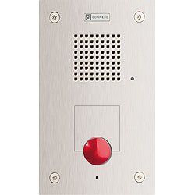
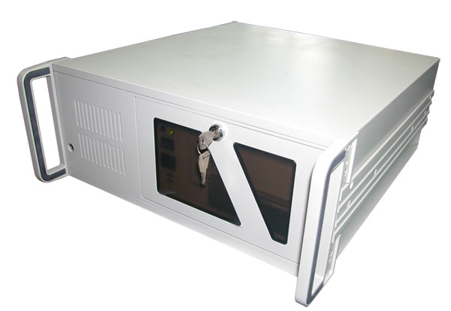
End-to-end solution for train radio systems
CAD & Voice
Recording Sub-
System
Trainborne
Sub-system
TRCP
API
BTS
API
TCI
Data
PA
Master Clock
PIS
Other
Sub-system
FOTS
PABX
PAS
PIS
Train Signalling
Train computer
ECB/EHP
Other Sub-systems
In metro
Train Controller
TETRA Radio System
Total Train Radio Solution

Slide 19
End-to-end solution for train radio systems
CAD & Voice
Recording Sub-
System
Trainborne
Sub-system
TRCP
API
BTS
API
TCI
Data
PA
Master Clock
PIS
Other sub-systems
FOTS
PABX
ATP centralized mgmt server
PAS
PIS
Station ATP
Train Signalling
Train computer
ECB/EHP
Other Sub-systems
Loco ATP
Train Controller
TETRA Radio System
Total Train Radio Solution
TCAS (Train Collision Avoidance System)?

Slide 20
Agenda
Wireless communication today
Wireless technologies - narrowband
Wireless technologies - broadband
Notes:
20
TYPE TREATMENT
Title is Arial Bold 32pt, ALL CAPS, Black, gray or color of the emsignia and colored bar on the cover slide
COLOR GUIDELINES
Only the colors from the Motorola Solutions color palette are acceptable (see brand guidelines: www.motorolasolutionsbrand.com)
Use only 1 color, plus black, white and gray
Do not use more than 1 color per slide
IMAGES: This area is reserved for imagery. All images are located on www.motorolasolutionscollective.com:
Images bleed on all 3 edges of the right side of slide
ADDITIONAL HELP
For additional informationPlease refer to the Motorola Solutions Guidelines: www.motorolasolutionsbrand.com
Be sure your Notes panel is open in PPT for information
and guidance throughout the document

Slide 21
Wireless technologies today…
Wideband / Broadband

Slide 22
WLAN evolution
802.11s for mobility – 2011
Realistic throughput with mobility @ vehicular speed:
802.11a/g ~12 Mbps
802.11n ~40 Mbps
802.11ac
1 Gbps
450 Mbps
802.11n
300 Mbps
802.11a
802.11g
54 Mbps
11 Mbps
802.11b
1 Mbps
1997
2000 - 2006
2008 - present
2015 & Beyond

Slide 23

A CULTURE OF INNOVATION
COMMERCIAL SPREAD SPECTRUM WLAN
WIRELESS LAN SWITCH
802.11n RF DESIGN TOOL
BAND-UNLOCKED RADIO FOR SECURITY, TROUBLESHOOTING, ACCESS
VoIP WLAN SMARTPHONE
SCANNER + WiFI MOBILE COMPUTER
FIXED WiMAX OUTDOOR LINK
MIMO POINT-TO-POINT LINK
AND 2800 PATENTS!
Notes:
23

Slide 24
WLAN ARCHITECTURE EVOLUTION
LED BY MOTOROLA
INDEPENDENT
STANDALONE
HUB AND SPOKE
CENTRALIZED
WiNG
DISTRIBUTED
FIRST WIRELESS LANS
MOBILE DATA ACCESS
NETWORK OF CONVENIENCE
COST EFFICIENT 802.11a/b/g WLAN
FILLED NEED FOR LARGER SCALE AFFORDABLE NETWORKS
BETTER QUALITY OF EXPERIENCE
MORE ROBUST, AFFORDABLE WAY TO HANDLE HIGHER NETWORK DEMAND
NO BOTTLENECKS
SCALABLE 802.11n
VoIP AND VIDEO RELIABILITY
SECURITY AT THE EDGE
LIMITED MOBILITY
DIFFICULT TO MANAGE
LIMITED SECURITY
LIMITED 11n SCALABILITY
BOTTLENECK AT WIRELESS CONTROLLER
LIMITED SECURITY/QoS
AT THE EDGE

Slide 25
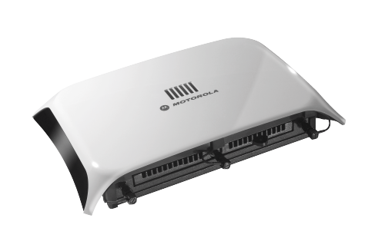
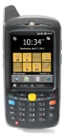
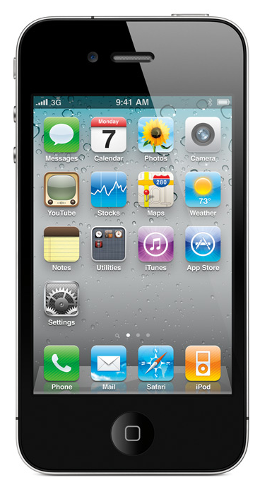
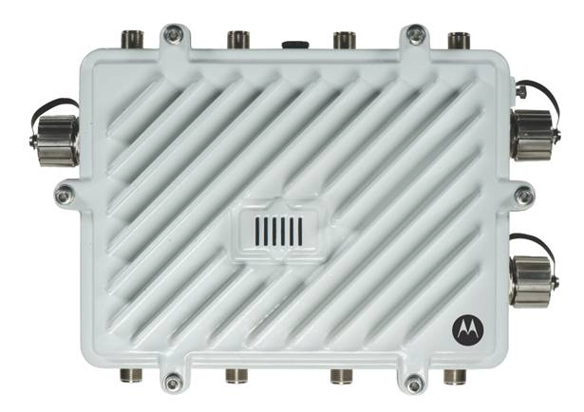





Motorola’s WLAN – built for mobility
Wireless broadband access in station and in trains
Intranet access
Workforce mobility solutions
Real-time CCTV and information from train to OCC
Internet access for public
Personal entertainment
3G/4G offload
Wireless intrusion detection & prevention (WIDS/WIPS)
Infrastructure
Management
Advanced Services
Network
Assurance
Security &
Compliance
Managed Services
Solutions
for Any
WLAN
Efficiency
Life cycle
Safety
Security
Experience

Slide 26
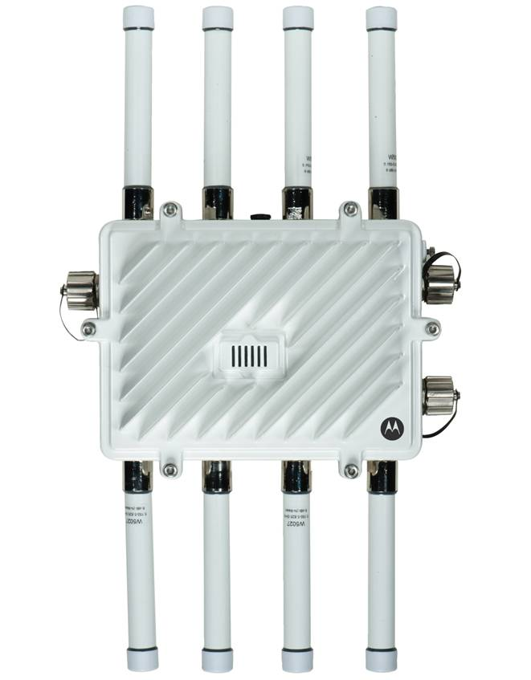


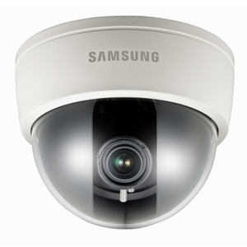
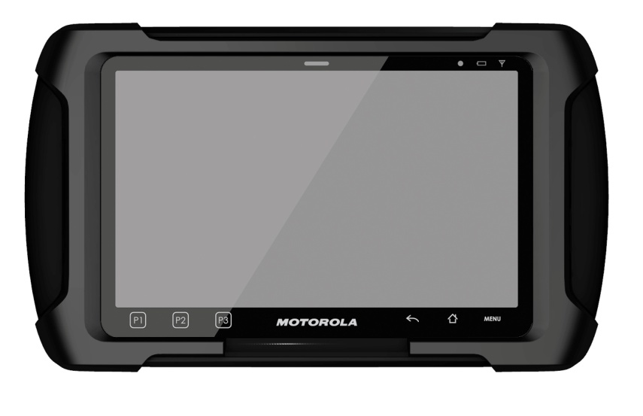
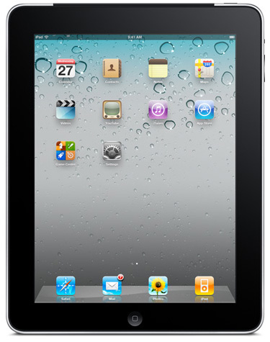

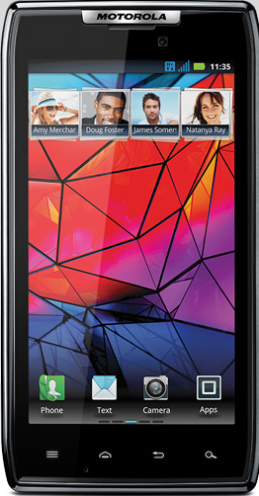
Wireless broadband using mesh WLAN
Mesh WLAN network along trackside
802.11n

Slide 27

Wireless cellular evolution
Rel | Main radio features
Rel-99 | WCDMA FDD & TDD
Rel-4 | TD-SCDMA
Rel-5 | HSDPA
Rel-6 | HSUPA
Rel-7 | HSPA+, EDGE evolution
Rel-8 | LTE
Rel-9 | LTE enhance
Rel-10 | LTE-A air interface
Source: Agilent Technologies

Slide 28
LTE for railways?
Passenger oriented
  Travel information
  Tourist information
  Real-time TV
  Personal multi-media entertainment
  Wi-fi internet access
Train/Crew services
  Crew communications
  Security
    diagnosis and maintenance
    CCTV
  Fleet maintenance

Slide 29

Wireless broadband using public carrier
3G / 4G public cellular network
WLAN access point with 3G/4G card
802.11n

Slide 30






In summary…
Data
TETRA mobile
TRCP
TCI
Voice, packet data, TEDS
Handheld
Applications
(e.g. WAP,
d/base query)
PA
Application servers
Mobile computing devices
CCTV surveillance
Intranet
PIDS or InfoMedia
Backend applications
Wireless infrastructure
Trackside
Trainborne
Efficiency
Life cycle
Safety
Security
Experience

Slide 31



