Slide 1




UIC Global Signalling & Telecom Conference
21 – 23 March 2013, Manekshaw Centre , New Delhi
Exhibition Layout by

Slide 2
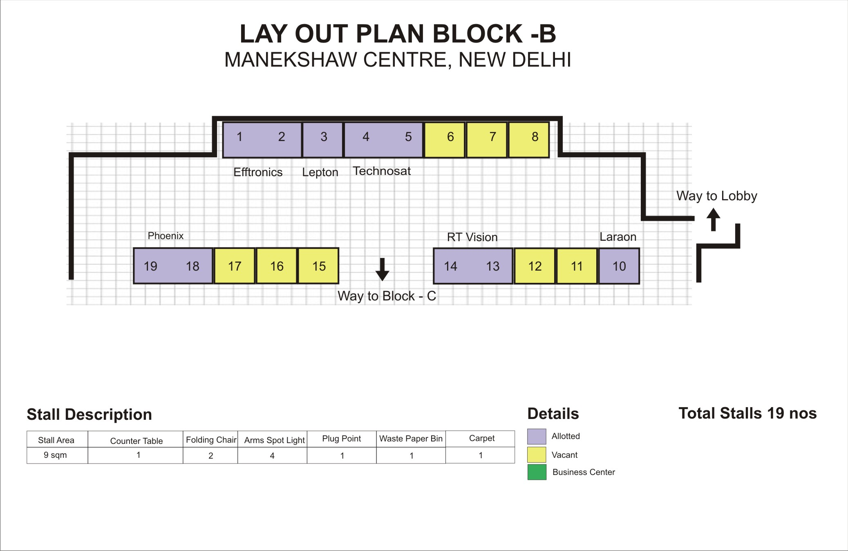


Slide 3
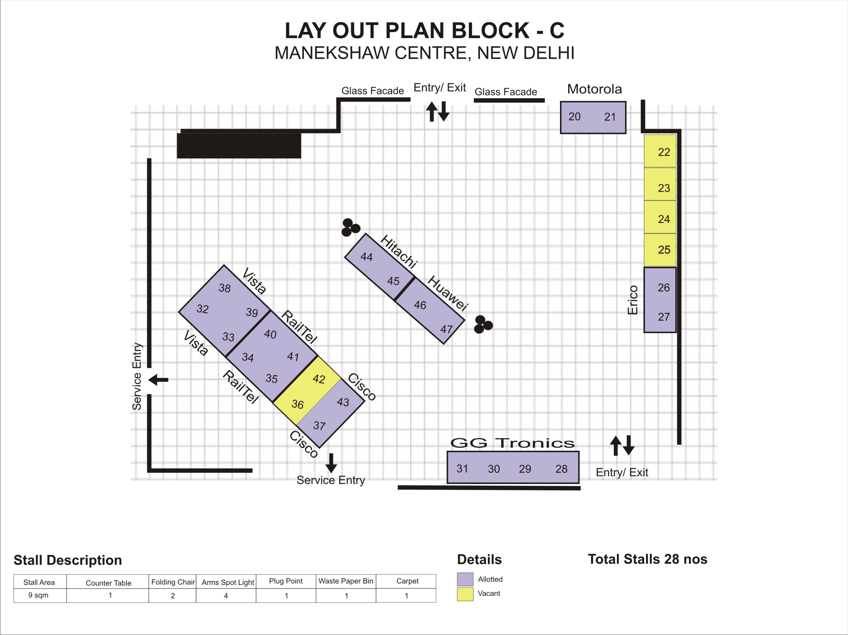

Slide 4
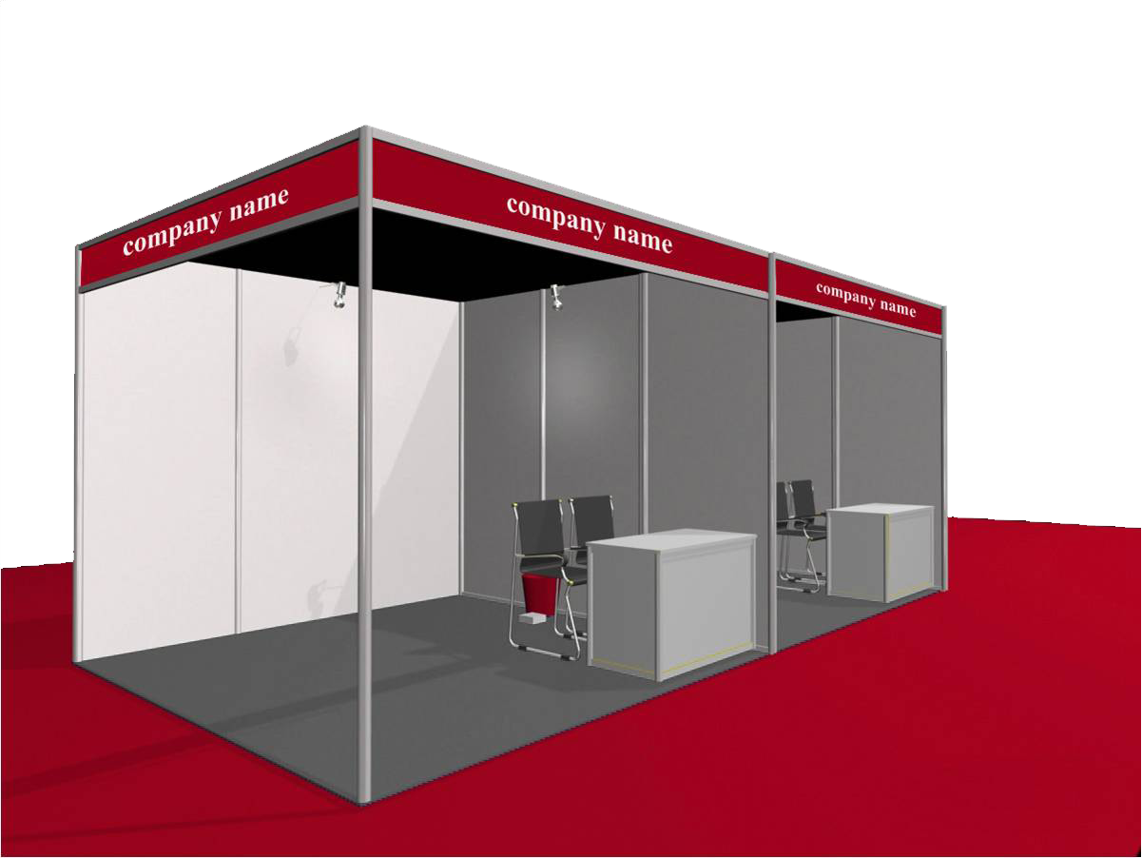
Sketch of shell scheme booth with specifications

