Slide 1
IRSE Exam Development Consultation with Stakeholders
Hedley Calderbank FIRSE (leading Exam Development work)

Slide 2
Remit of the Review
In December 2017 E&PD Committee recommended to Council that the structure and format of the IRSE Professional Examination be reviewed
Council approved the proposal to undertake the review
In January 2018 E&PD Committee approved the following remit to the Review Group:
Consider and recommend (with reasoned arguments) any desirable changes to the structure, standards, administration (and any other relevant matters) of the IRSE Professional Examination having regard to:
Council’s stated wish (following the disappointingly low pass rate in the 2015 exams) for changes to achieve:
Higher percentage pass rates without degrading the examination status
A sustainable examiner workload
An improved candidate experience
Developments in the following areas in the 23 years since the examination structure was last changed:
Changes in signalling, communications and control technology
Changes in employment patterns
Developments in the automation of examination marking
Developments in the theory of assessment methods
A high proportion of non-UK candidates taking the exam

Slide 3
Review Group Membership
Chair - Dr Daniel Woodland (Council Member)
Secretary - Hedley Calderbank (EPD Committee)
Members
Examination Committee:
Tony Kornas (Chair & EPD member), supported by Roger Short & Ed Rollings
Younger Members Committee:
Keith Upton (Chair)
Licensing Committee:
Colin Porter (Chair)
Recent Exam Candidates:
Tom Corker (Thorrowgood Scholar)
Kimberley Chang (current candidate)
Academia and international:
Hongsin Kim (University of Birmingham / Korea)
Les Brearley (IRSE education Australia & Central Queensland University involvement)
Membership Committee by consultation outwith meetings

Slide 4
Summary of Review Group Findings
The IRSE Professional Examination is a rigorous and well-respected test of knowledge, understanding and ability
Its primary purpose is as a stimulus to learning (particularly a breadth of knowledge and understanding that may not be acquired in a person’s narrow job – including interfaces with other railway engineering disciplines and operations)
The examination is supported by a dedicated and professional team of volunteer examiners
Hardly any candidates enter the communications modules (always single figures – sometimes one or zero), but those in this specialisation still need to be catered for
In principle the content of all 7 existing IRSE Exam modules remains relevant.
It is uncertain how Module 2 could be applied to ETCS and CBTC. The Module 2 syllabus can be better examined as focused questions within a module on broader approaches, rather than an hour and a half signalling a layout which is more a test of exam technique. Noted that legacy signalling does still need to be covered

Slide 5
Summary of Review Group Findings
The concept of a ‘foundation level’ qualification covering fundamental knowledge across all aspects of railway signalling, control and communications, but set at a lower level could attract a much larger field of potential candidates and could be sat online and use automatic marking. This could also serve as a pre-qualification for the full professional examination.
The pass rate has been unacceptably low (as observed by Council) and even though it has increased in 2017 and 2018, it is still out of line with most other professional exams. Increasing the pass rate (without degrading the exam) must come from candidates being better prepared. Options for this are:
Introduce one or more taught courses
Introduce a “fundamentals” exam as a pre-qualification to filter out unsuitable candidates
Introduce a “foundation qualification” so that unsuitable candidates are not under pressure to take the whole exam because nothing else exists.
A mandatory test of breadth of fundamental knowledge across all aspects of railway control and communications (no choice of questions) could be complemented by in depth testing of understanding of principles and applications in the candidates preferred specialist areas (choice of questions)

Slide 6
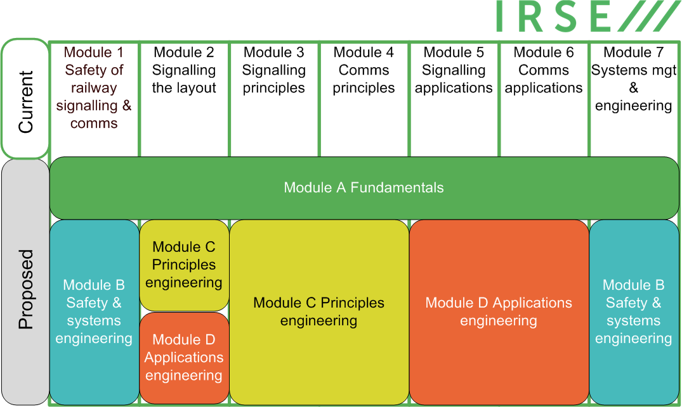
Mapping Old to New Modules

Slide 7
New Module Structure
Council endorsed that the module structure should be revised to encourage breadth of learning across the integrated systems that are captured within the current examination syllabus and simplified to comprise 4 modules:
Module | Title | NVQ (ind.) | Scope | Assessment Method | Module Syllabus Mapping
A | Fundamentals of Railway Control Engineering | 4 | Breadth of signalling, communications, systems & interfaces knowledge. Everything you would ideally expect a junior engineer or manager, software developer, etc. working in the discipline to know | Multiple choice (and variants). No choice of questions | High level overview of all
B | Railway Safety & Systems Engineering | 6 | Breadth of knowledge and understanding in Safety and Systems. Similar to Modules 1 & 7 together. Everything you would ideally expect an aspiring professional engineer working in the discipline to know | 3 x 30 minute questions with a choice from 10 questions. | Modules 1 & 7
C | Principles of Railway Signalling, Control & Communications Systems | 6 | Depth of knowledge and understanding in the principles of signalling, communications, systems & interfaces. | 3 x 30 minute questions. Wide choice of questions to accommodate a candidate’s specialisation | Modules 2(pt), 3 &4
D | Applications of Railway Signalling, Control & Communications Systems | 6 | Depth of knowledge and understanding in the applications of signalling, communications, systems & interfaces | 3 x 30 minute questions. Wide choice of questions to accommodate a candidate’s specialisation | Modules 2(pt), 5 & 6

Slide 8
Proposed Qualifications
Certificate in Railway Control Engineering Fundamentals after passing Module A
Diploma in Advanced Railway Control Engineering (aka “IRSE Professional Examination”) after passing all modules
Module A to be offered more than once a year and to be a pre-qualification to proceed to the other modules.
Modules B, C, D to be offered once a year as at present

Slide 9
Advantages of New Exam Structure
Simplifies the structure from 7 to 4 modules
Examiner workload the same or lower
Module A can filter unsuitable candidates and possibly supplant the current sponsorship system
Awarding a qualification for Module A means that candidates who could not pass the advanced modules are not under pressure to try
Module A can be promoted to a wider population and encourage learning by project managers and others working with our profession
Solves the question of the future of Module 2
Should increase the pass rate
Selectively modernises the exam in line with current assessment techniques
Module A serves as a trial for possible future developments in the advanced modules

Slide 10
Migration
Migration rules set out what combinations of old and new modules will qualify for passing the IRSE Professional Examination
Before candidates commit to take the final year of the old modules, we will publish:
migration rules
example papers for modules B, C & D
(if possible) sample answers for the questions in those papers
guidance on the type of questions in module A

Slide 11
Computer based examinations
Now in widespread use in professional institutions and universities
Forget the poorly designed multiple choice tests with single answers. They can be far more sophisticated and challenging
Intended to be used for module A because:
Many short questions better for a “breadth not depth” exam
Marking can be automated
Enables push to promote the exam beyond the traditional candidates
Could enable exam to be offered multiple times in a year
Logistical challenges ( IT environment, anti-cheating etc.) being worked on.

Slide 12
Timeline
June 2018 – Council approved new module structure in principle
21 March 2019 – E&PD Committee approved revised syllabus
26 April 2019 – Seek Council approval for implementation
Nov 2019*– Publish example question papers for new modules
Nov 2019*– Publish permitted combinations of old and new modules
Feb 2021* - First Module A exam
Oct 2021* - First Module B, C, D exams
* These dates will be earlier if October 2020 is decided for B, C, D implementation
Current exam structure remains unchanged for October 2019 (& 2020 too, depending on Council decision)

